Slide 1
Algorithms

Slide 2
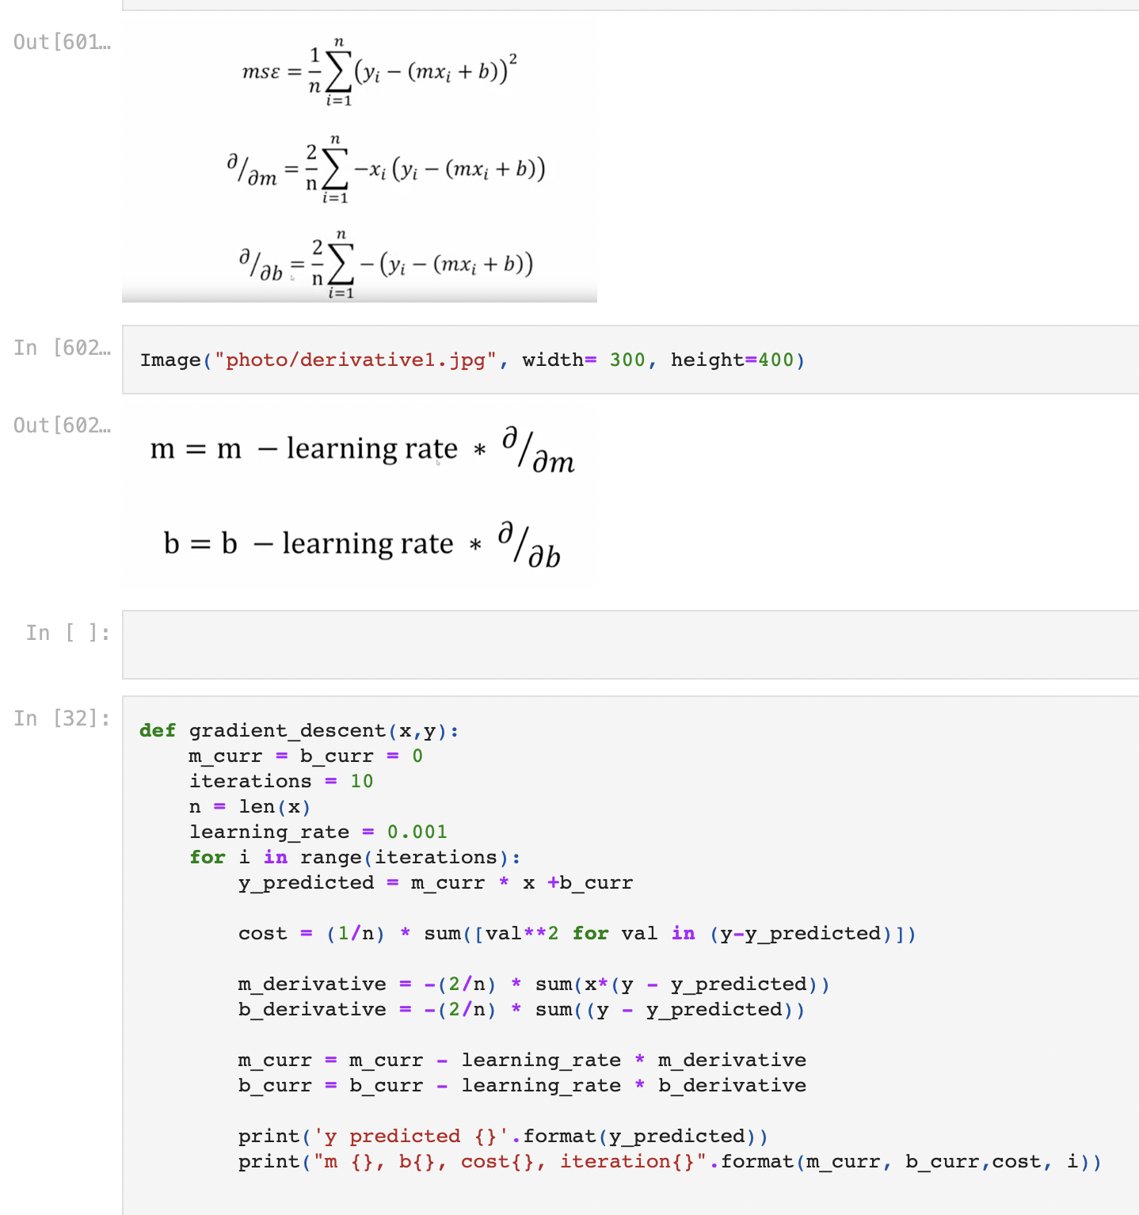
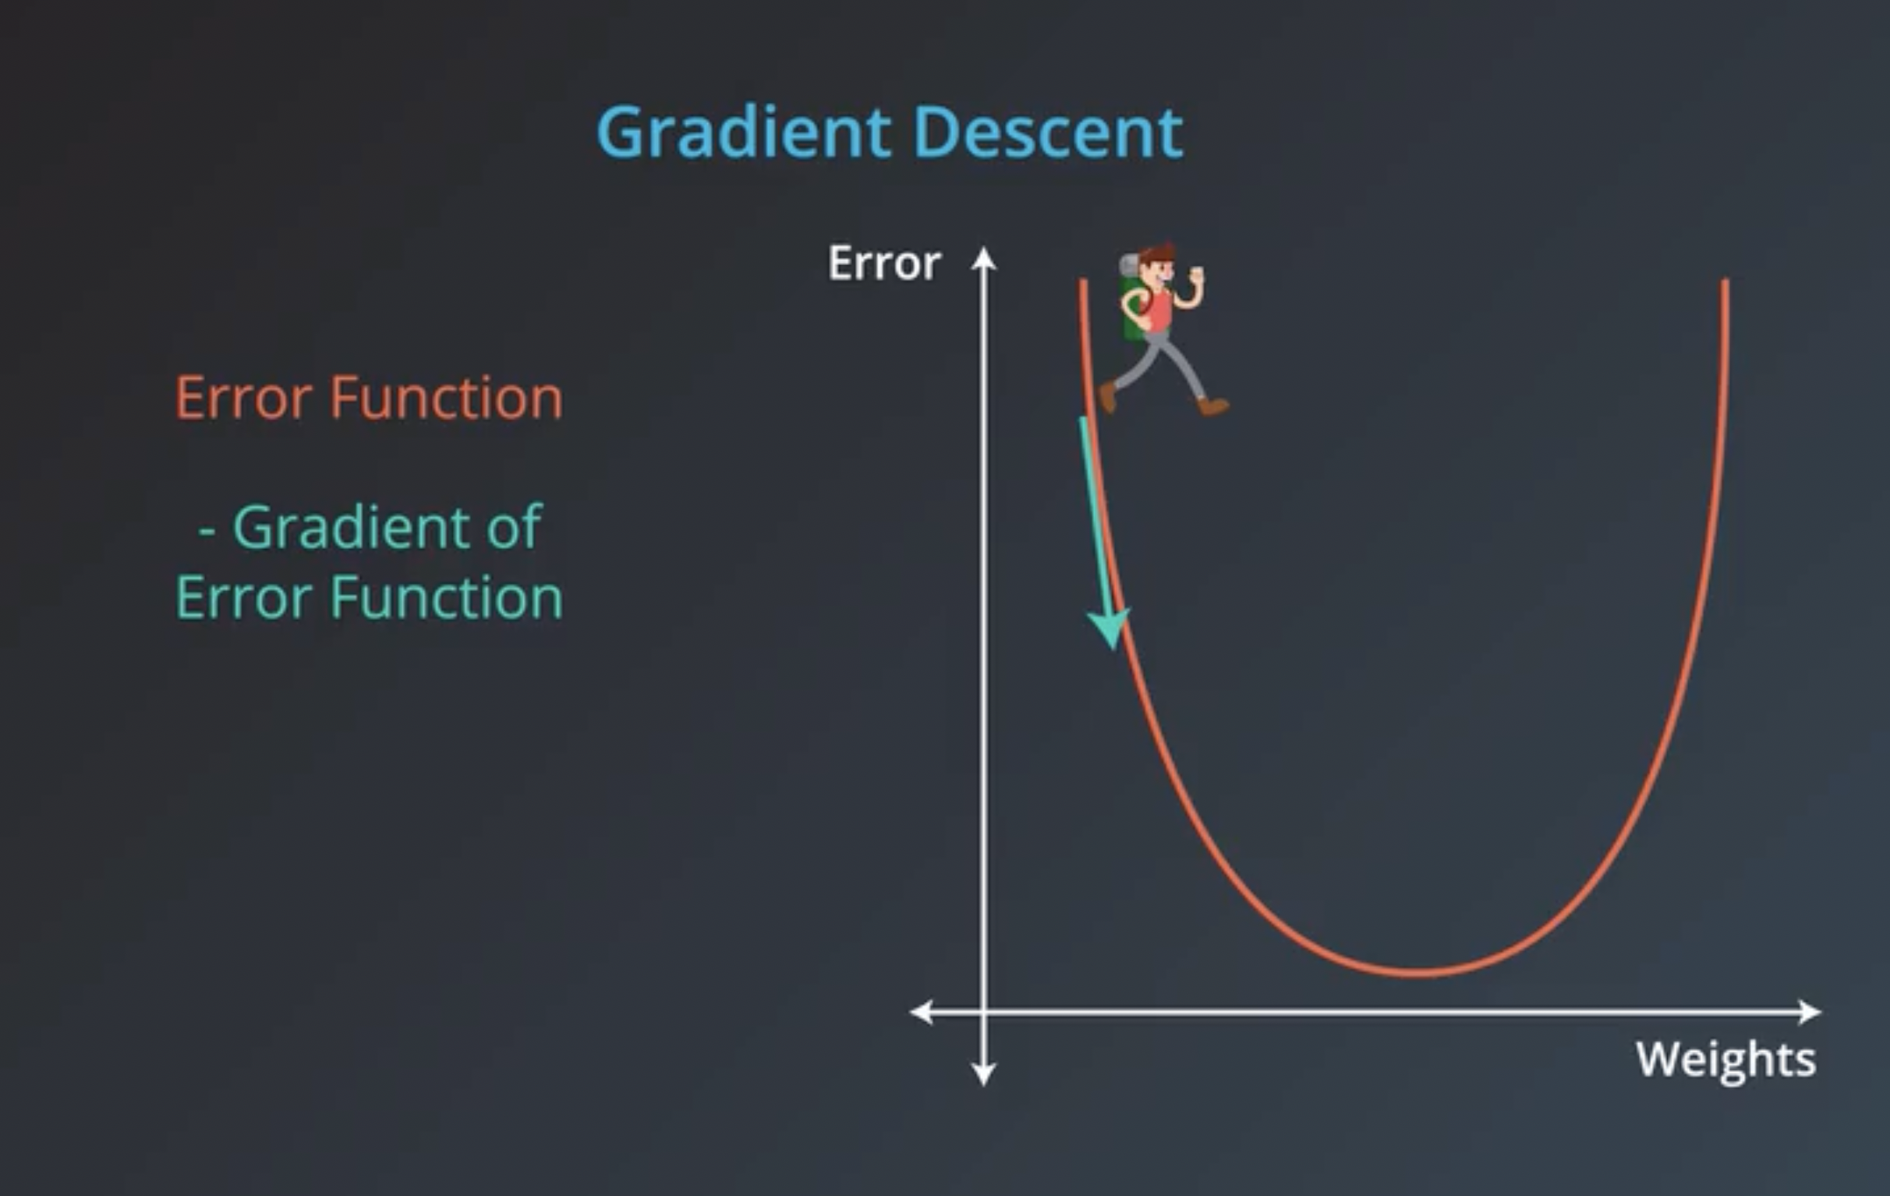
Linear regression
Notes:
Our goal is to minimize this error to obtain the most accurate value of weights
Mean squared error (MSE)
A gradient measures how much the output of a function changes if you change the inputs a little bit." — Lex Fridman
A gradient simply measures the change in all weights with regard to the change in error. You can also think of a gradient as the slope of a function. The higher the gradient, the steeper the slope and the faster a model can learn. But if the slope is zero, the model stops learning. In mathematical terms, a gradient is a partial derivative with respect to its inputs.
https://builtin.com/data-science/gradient-descent

Slide 3
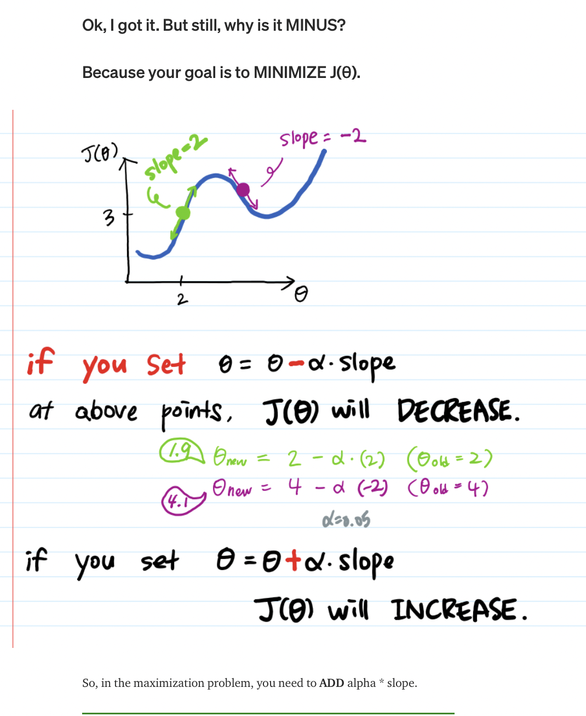
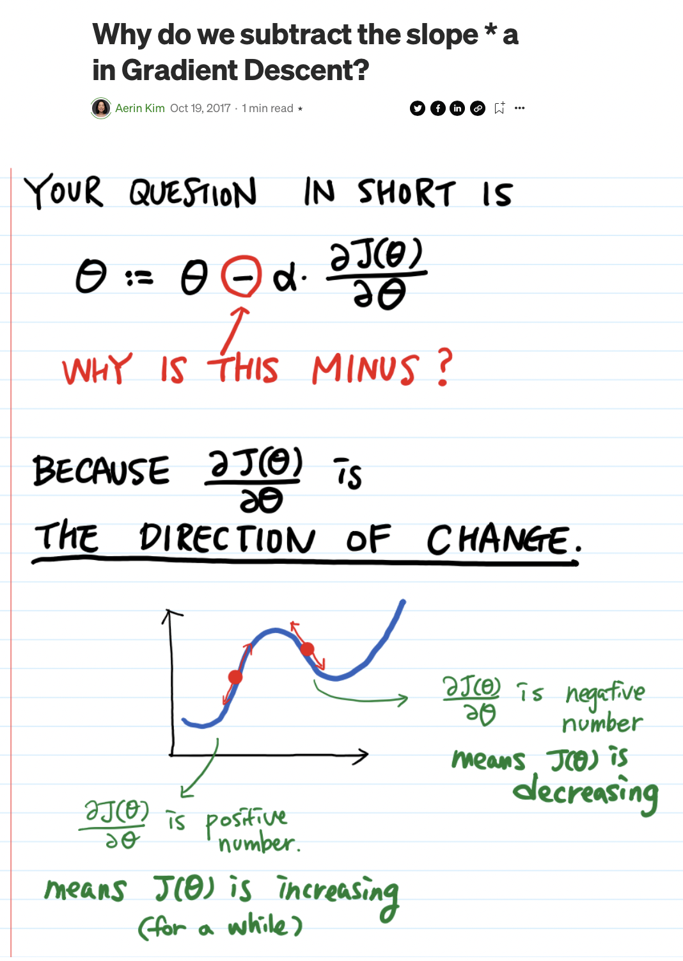
Why substract?
Notes:
https://automata88.medium.com/why-do-we-subtract-the-slope-a-in-gradient-descent-73c7368644fa

Slide 4
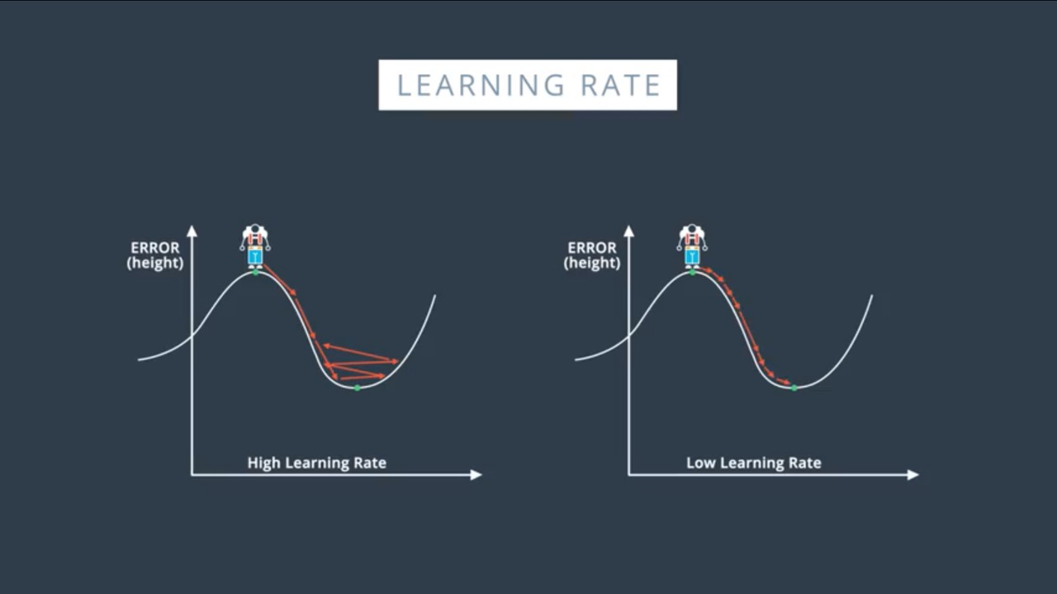
Learning Rate
Learning Rate
More time to reach local/global minima
Learning Rate
Might not reach to minima
Good starting point : 0.01

Slide 5
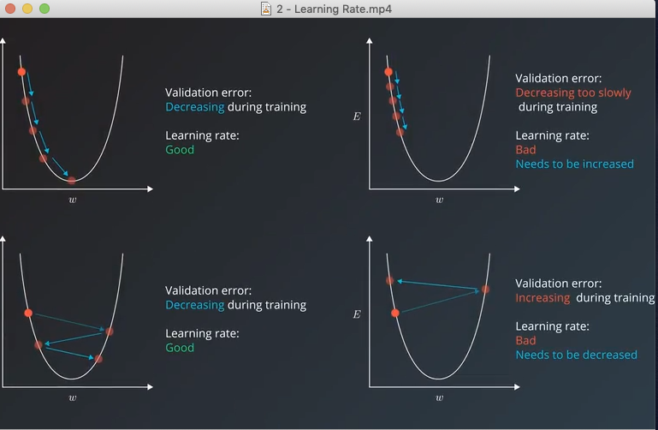
Learning Rate

Slide 6
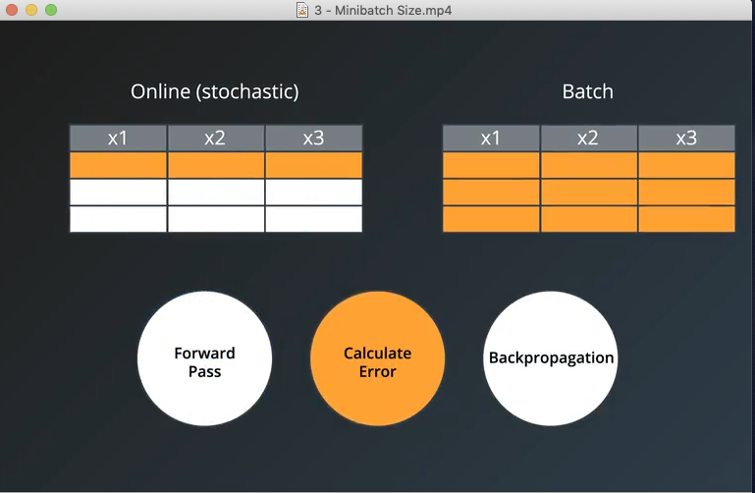
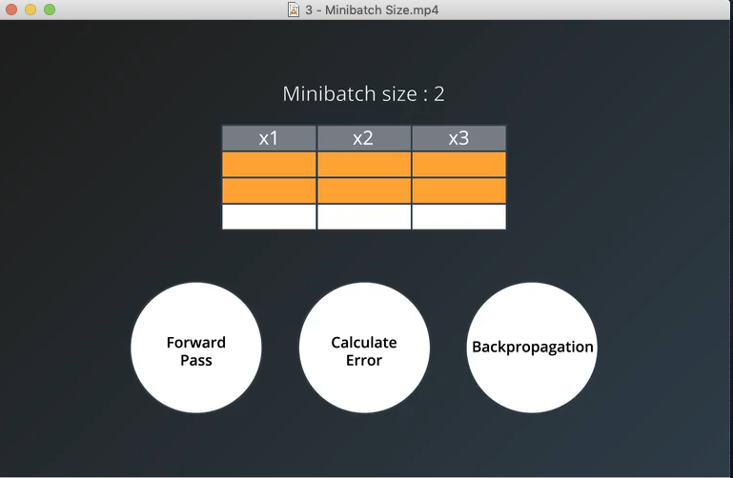
Batch

Slide 7
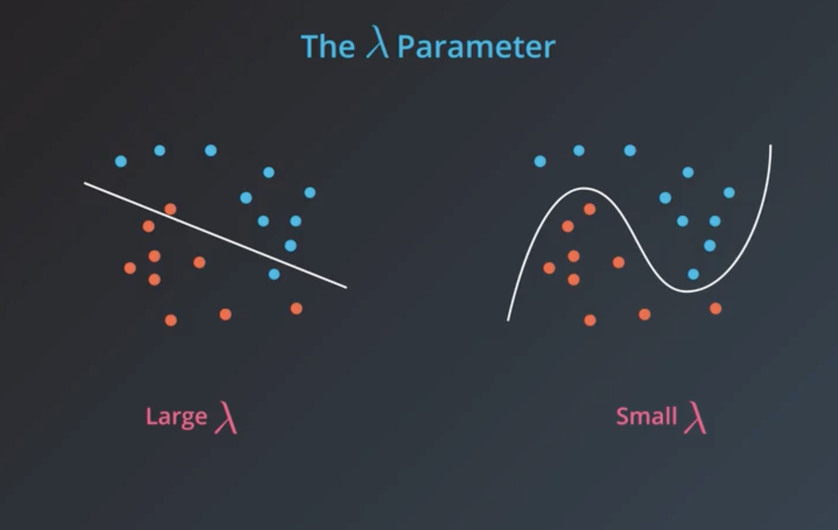
Regularization
Notes:
If we want simpler model, we choose large lambda, and penalize more-
If we want complex model, we choose small lambda, penalize less
L1- lasso
L2- ridge

Slide 8
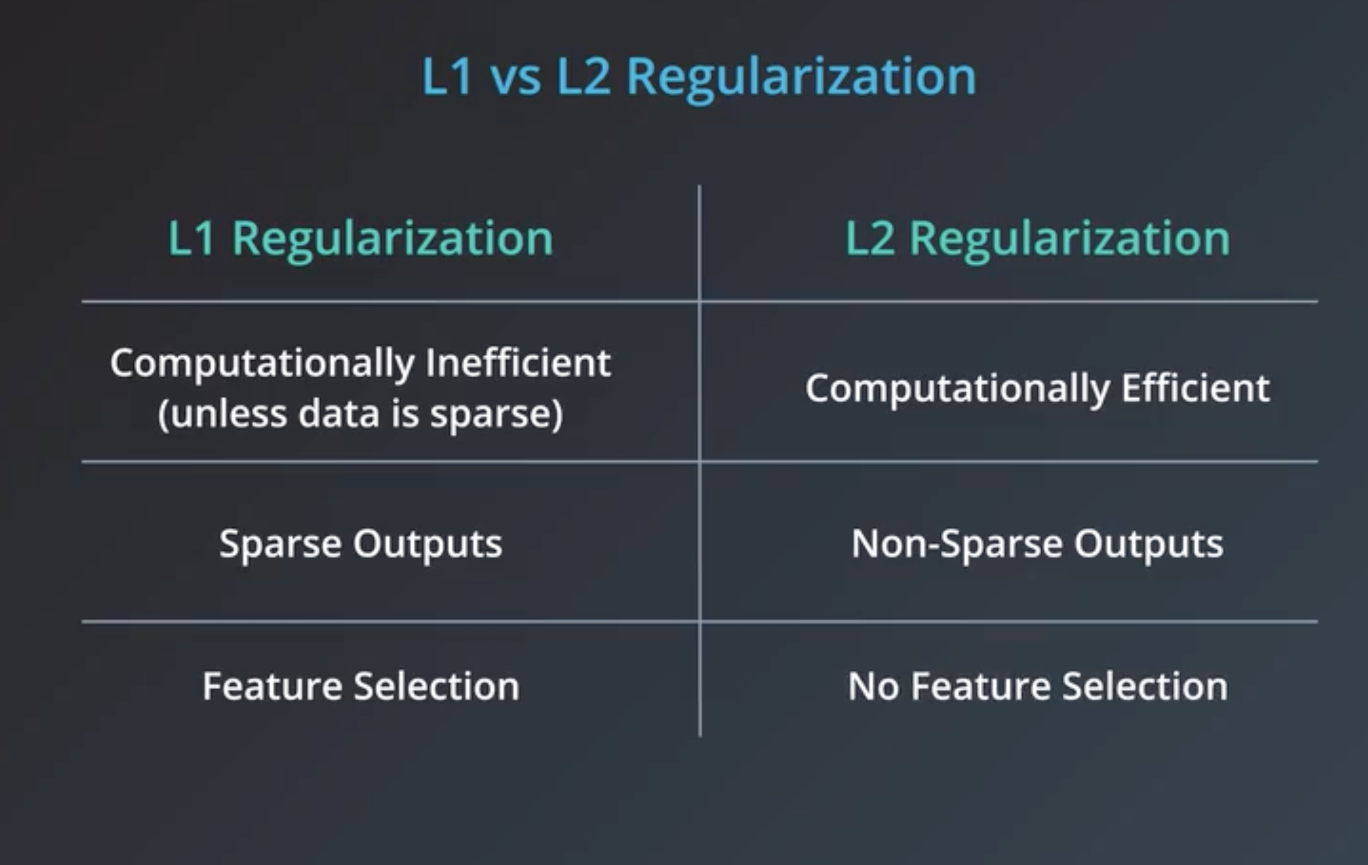

Slide 9
Logistic Regression

Slide 11
Decision Tree

Slide 12
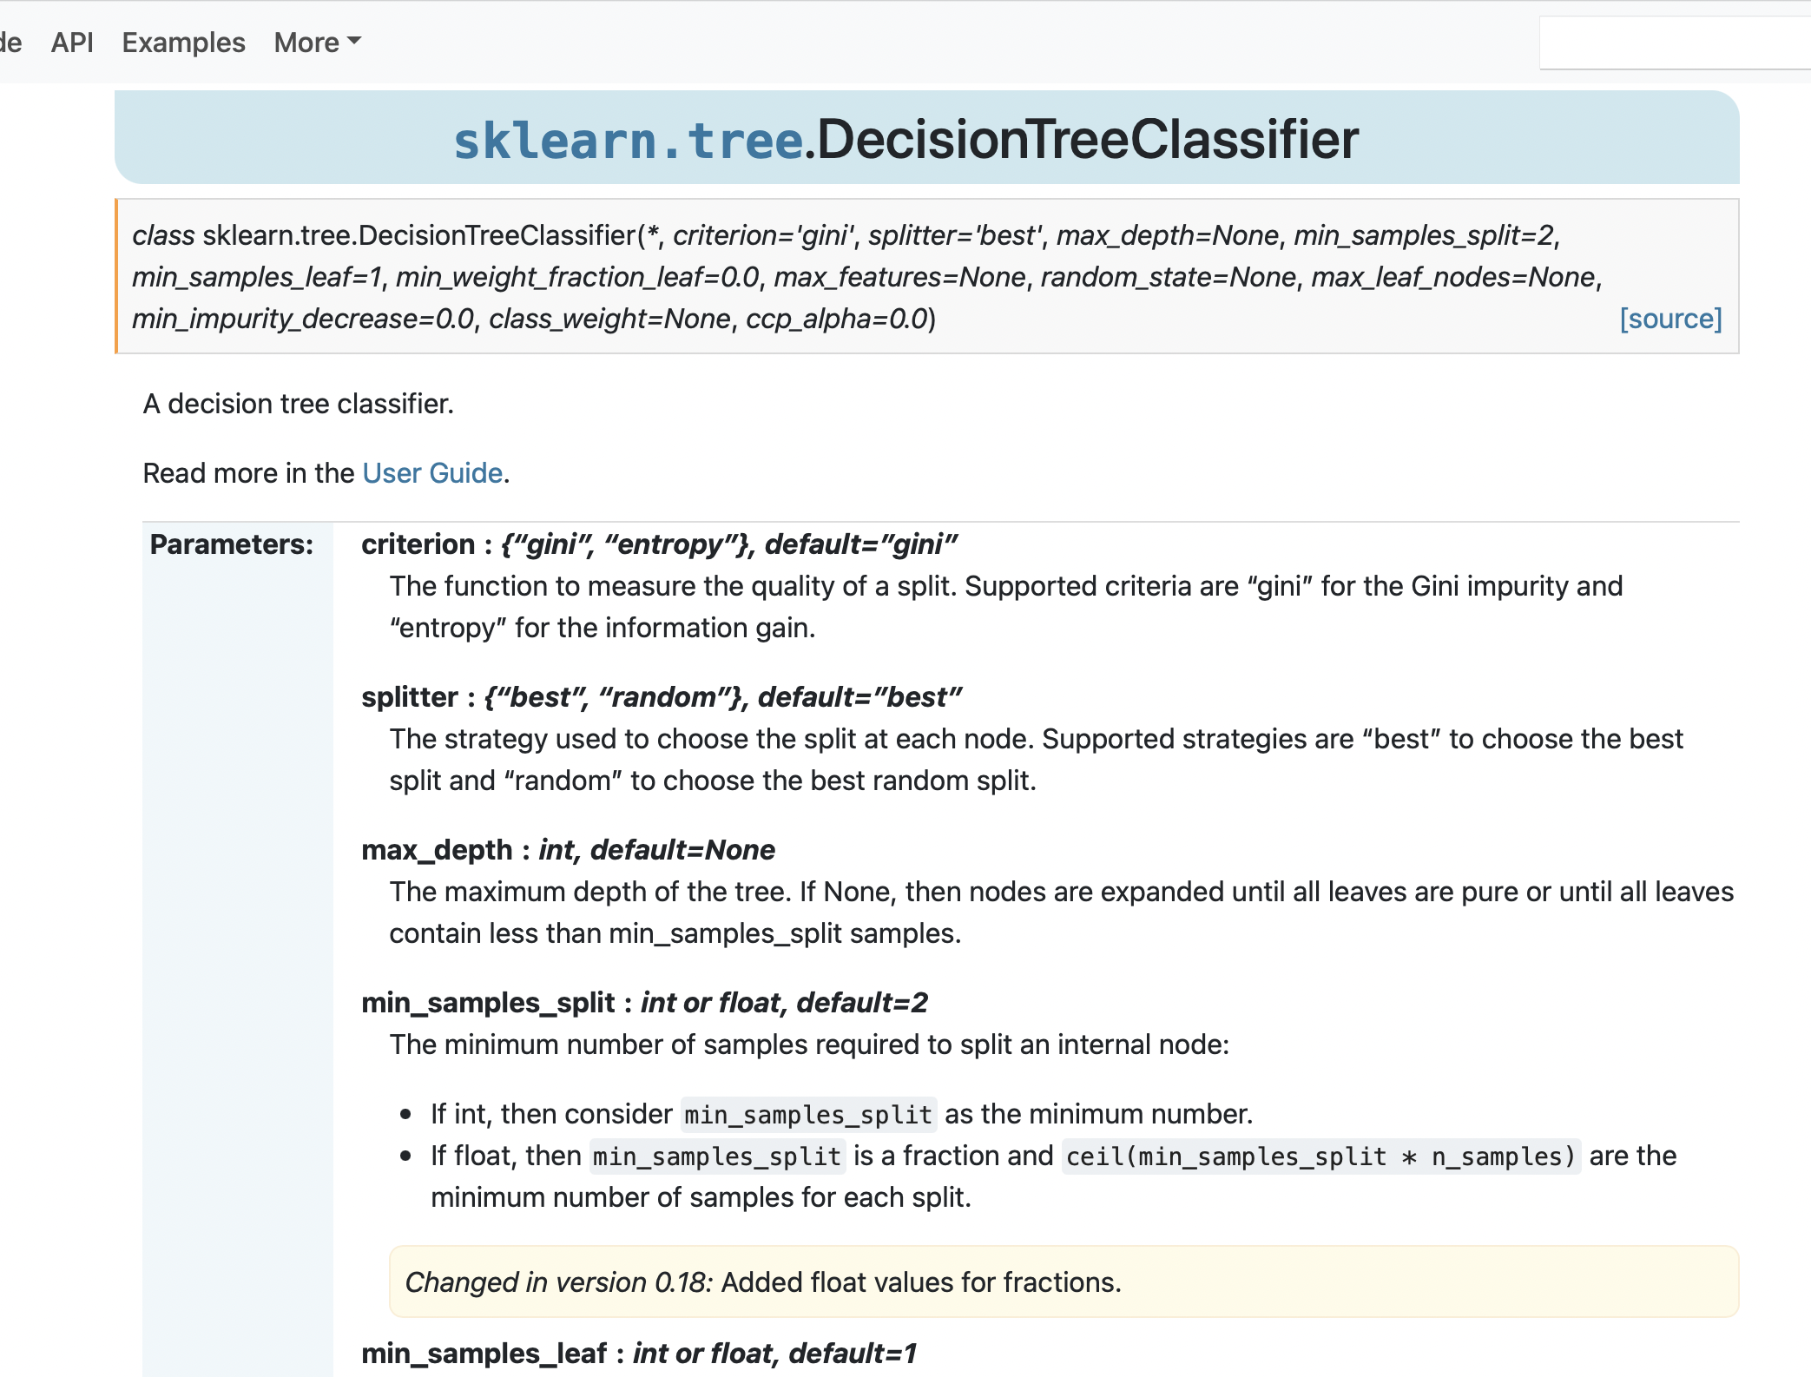

Slide 13
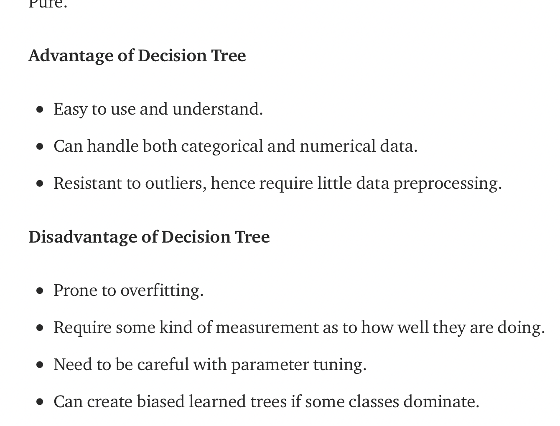
Decision Tree
Notes:
https://towardsdatascience.com/decision-tree-in-machine-learning-e380942a4c96

Slide 14
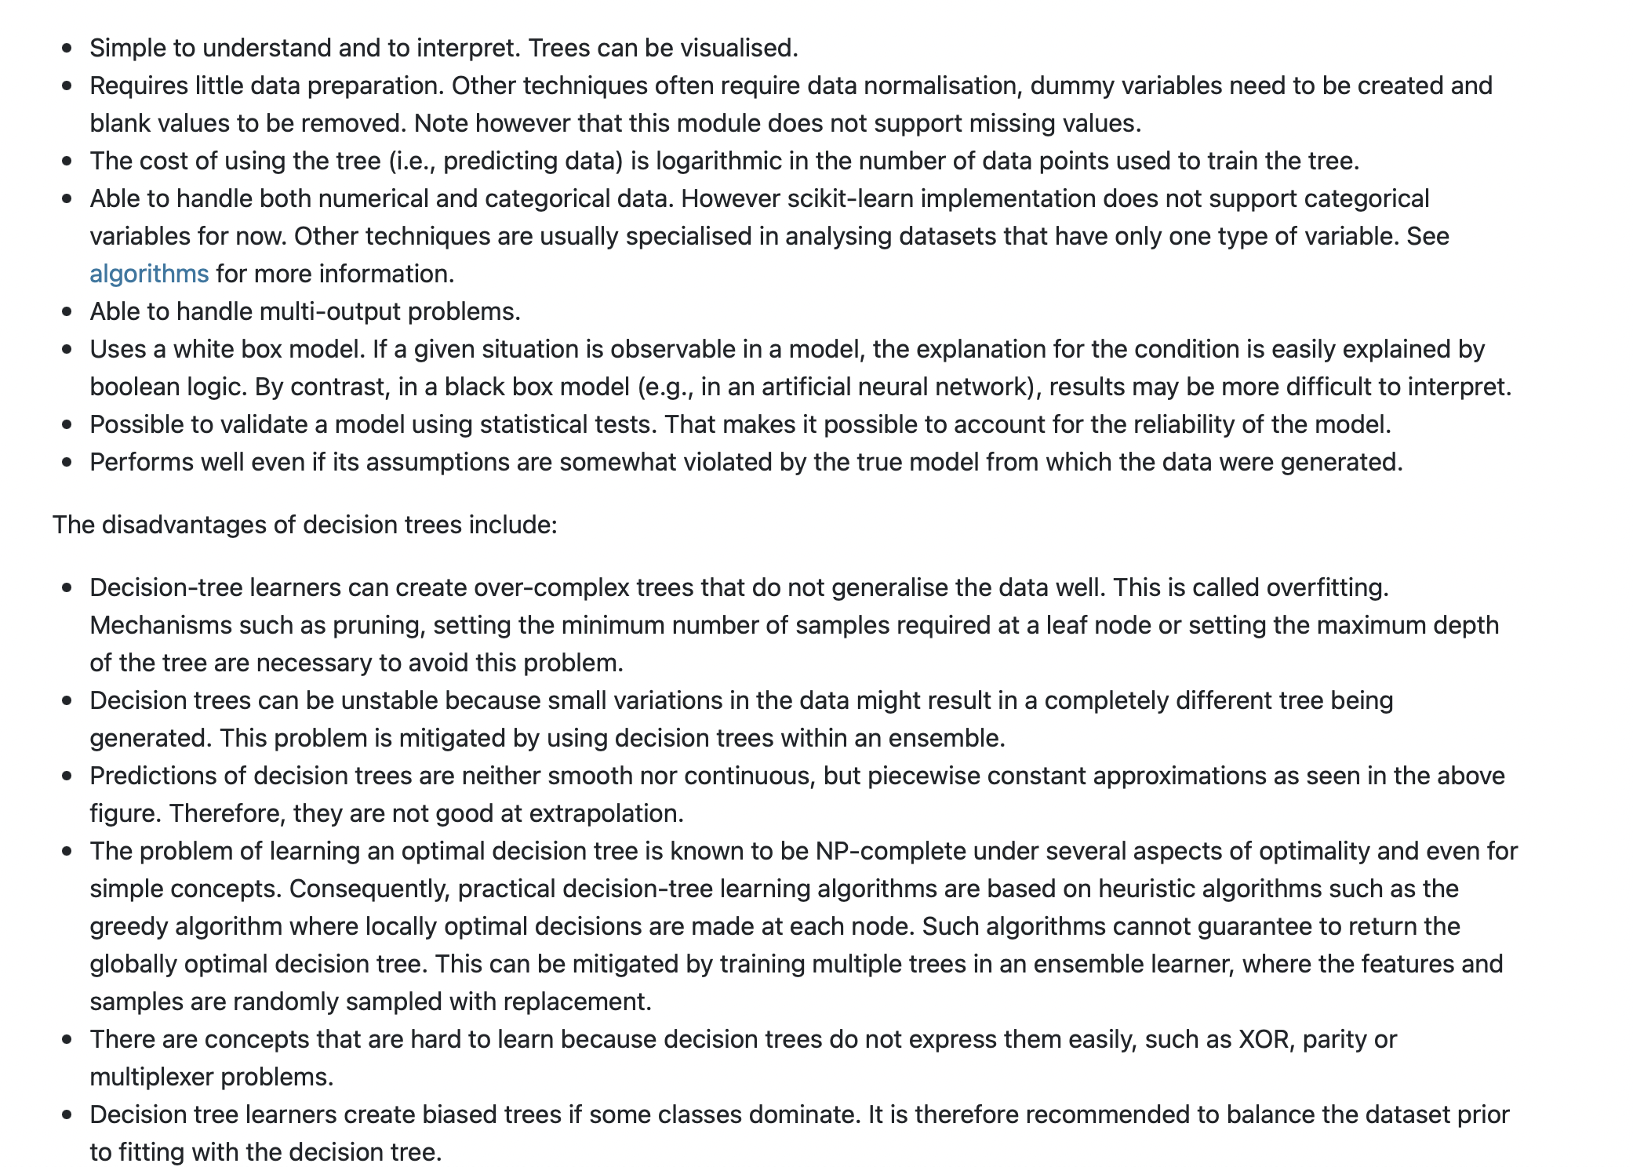
Decision Tree
Notes:
https://scikit-learn.org/stable/modules/tree.html

Slide 15
Decision Tree
Notes:
https://scikit-learn.org/stable/modules/tree.html

Slide 16
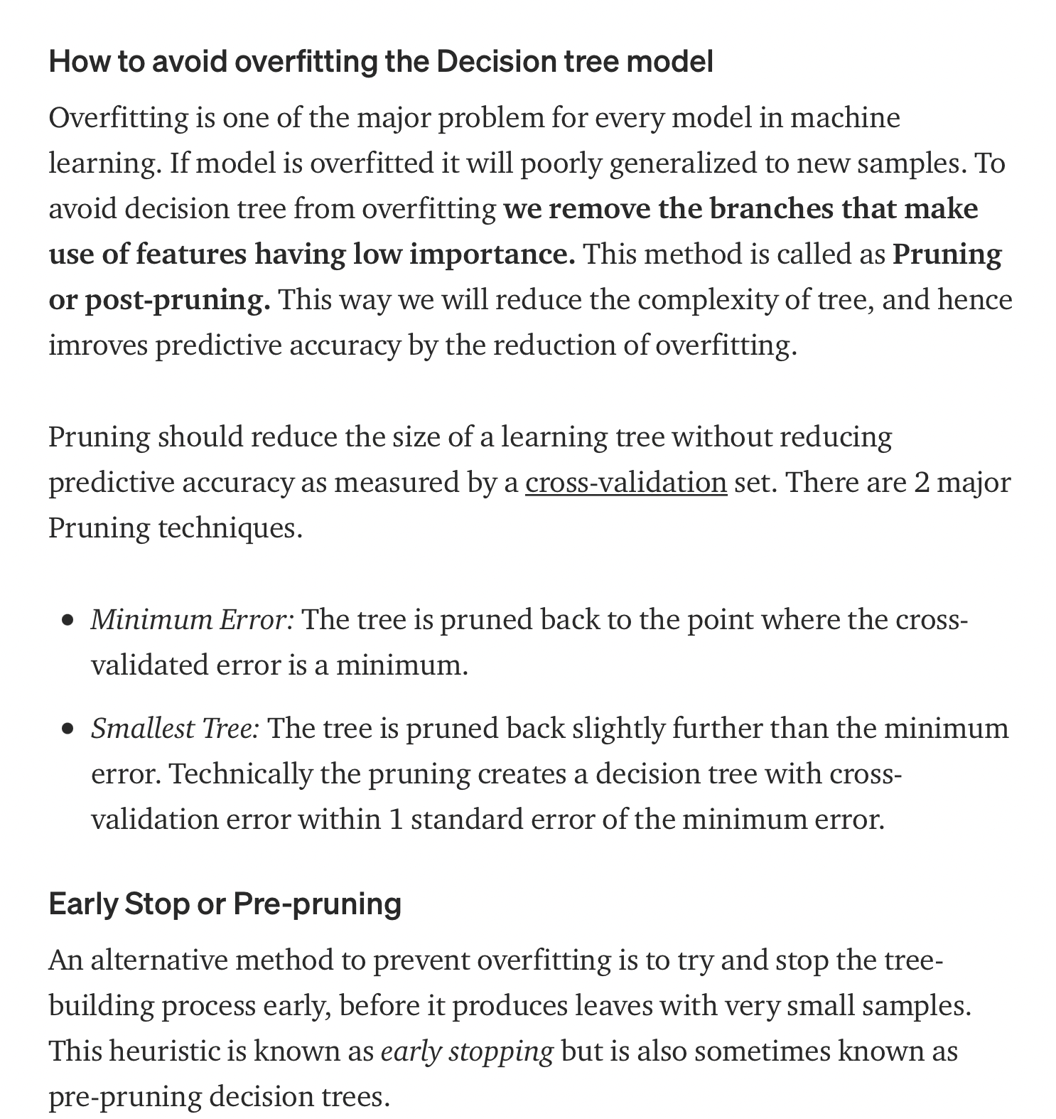
Decision Tree
Notes:
https://towardsdatascience.com/decision-tree-in-machine-learning-e380942a4c96

Slide 18
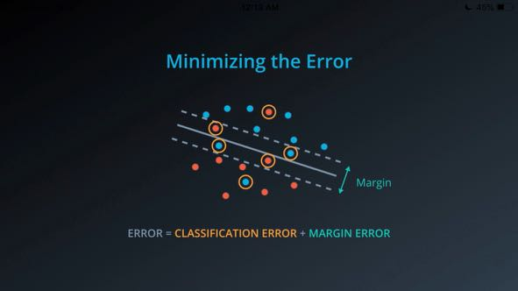
SVM

Slide 19
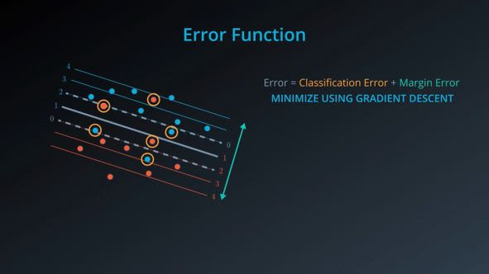

Slide 20
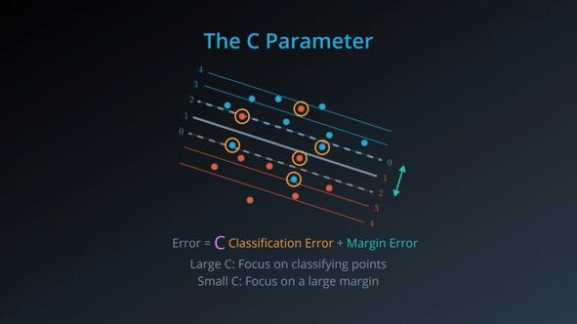

Slide 21
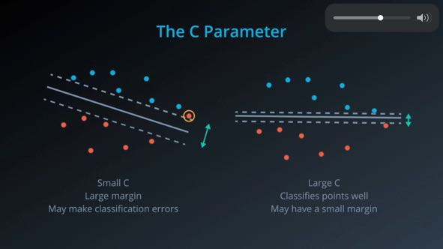

Slide 22
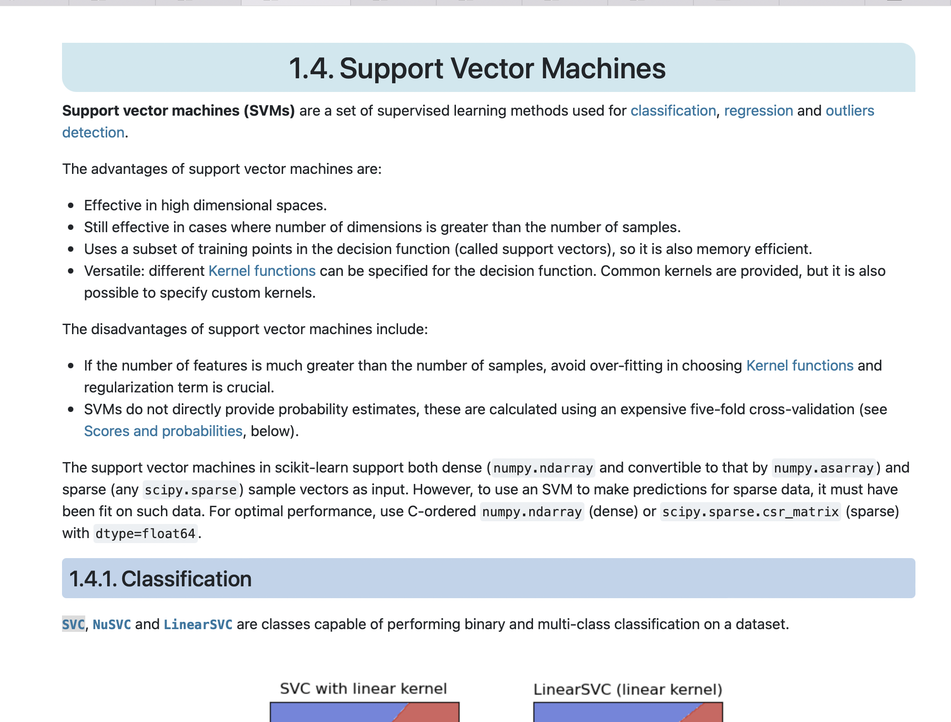
Notes:
https://scikit-learn.org/stable/modules/generated/sklearn.svm.SVC.html#sklearn.svm.SVC

Slide 23
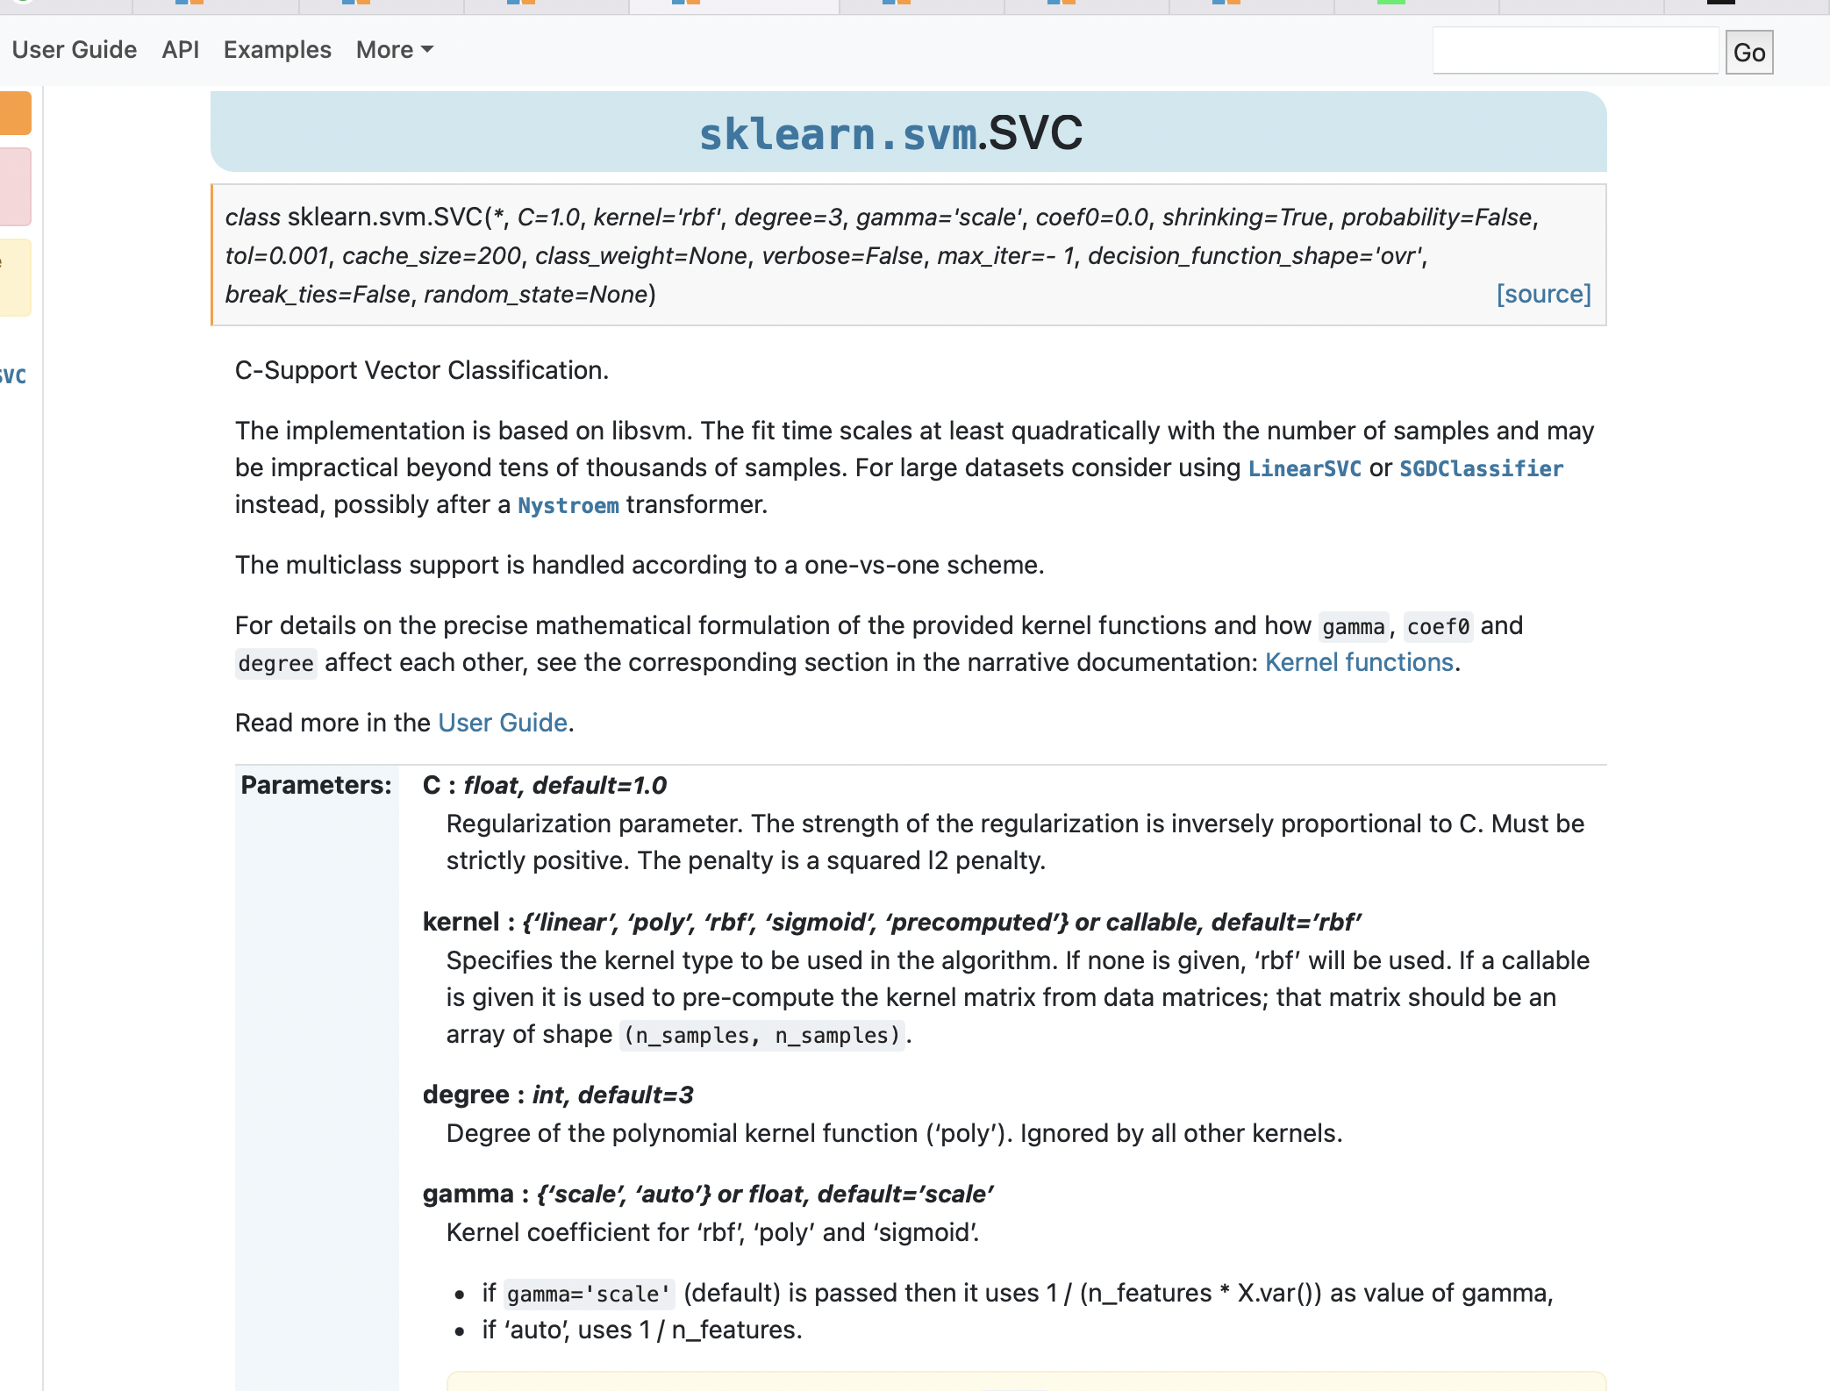
Notes:
Radial Basis Function (RBF)
Gamma is a hyperparameter in rbf

Slide 24
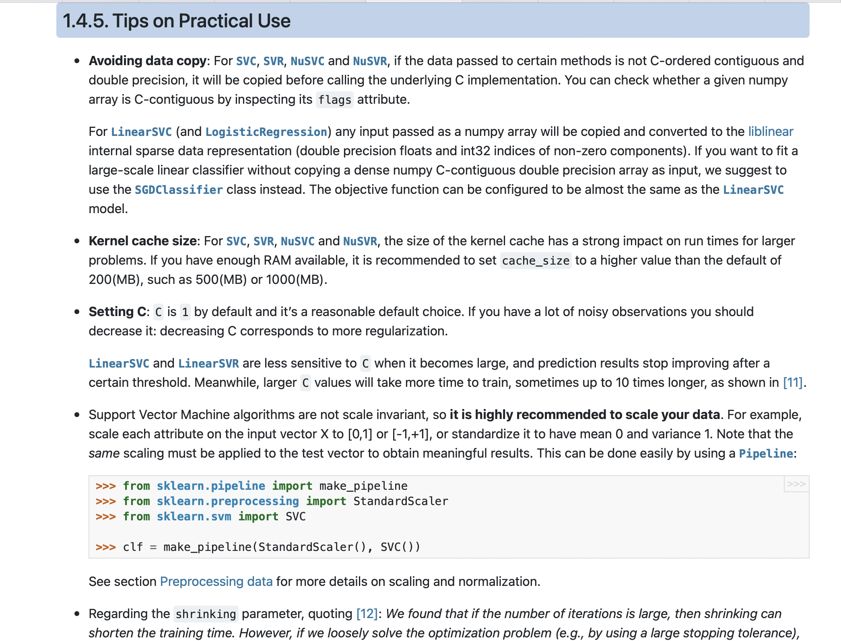

Slide 25
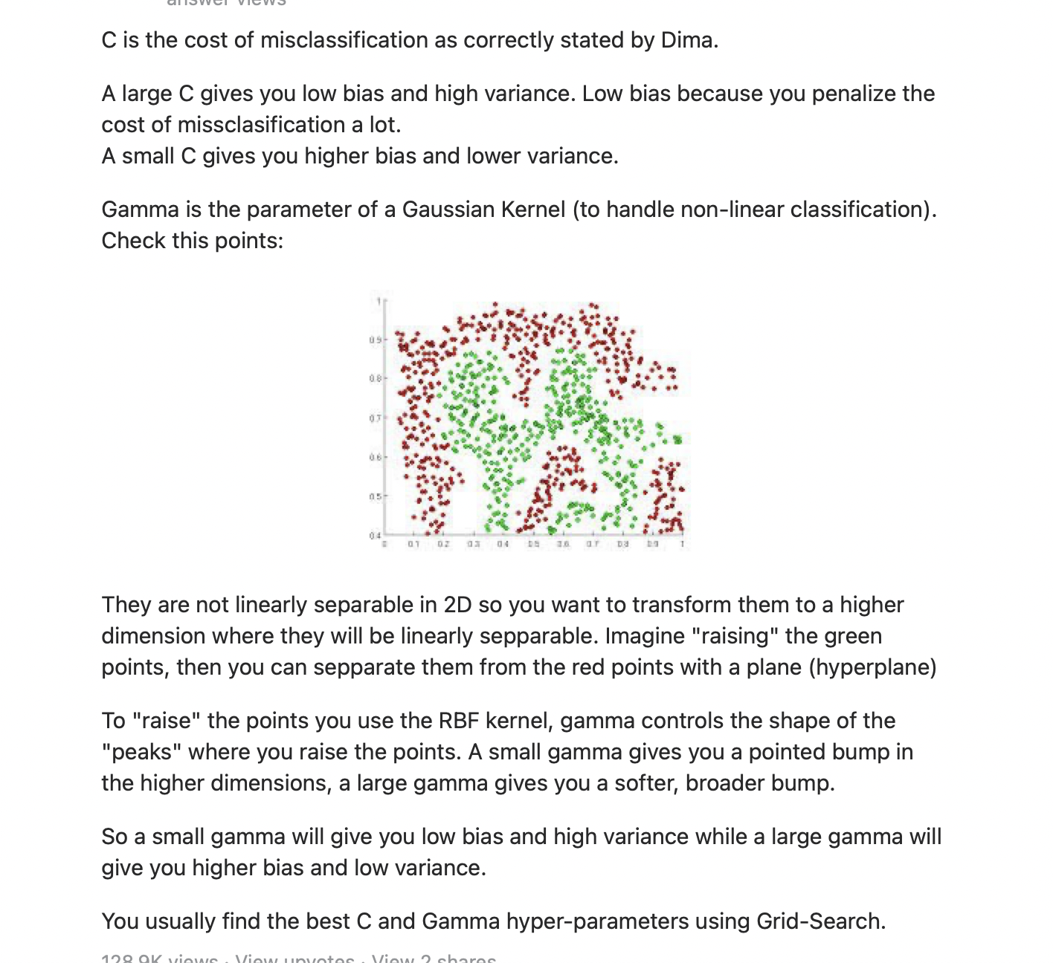

Slide 26
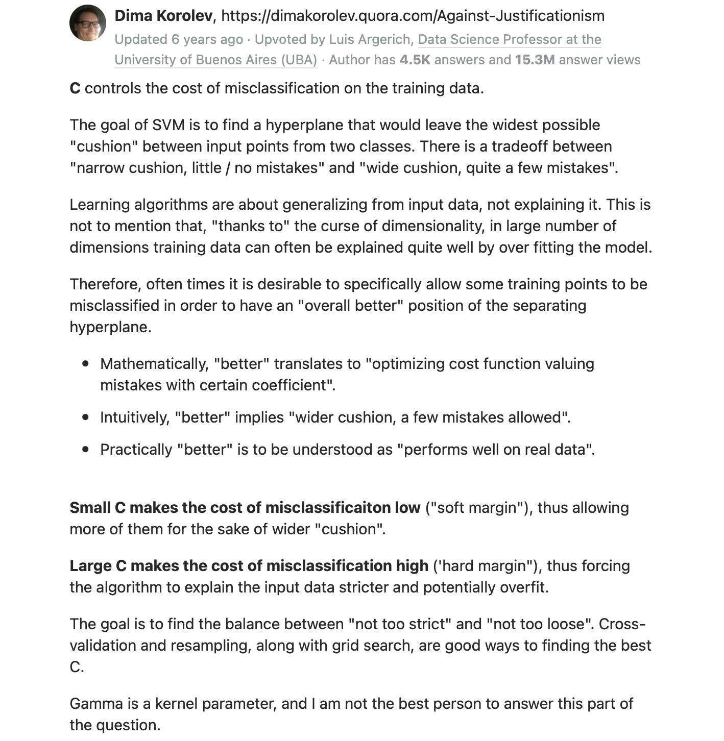

Slide 27
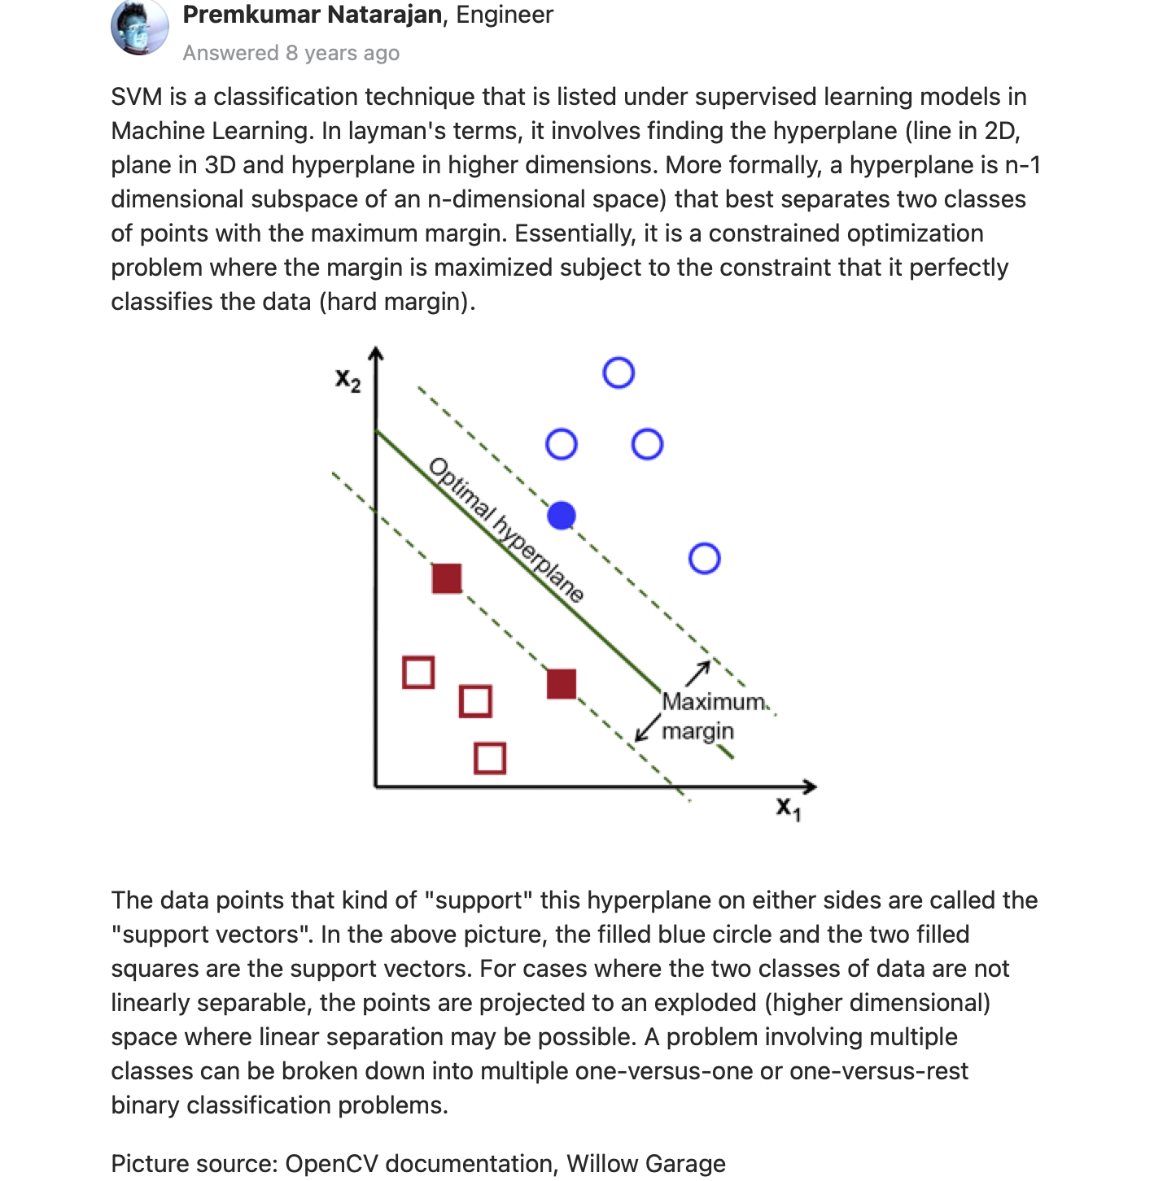

Slide 28
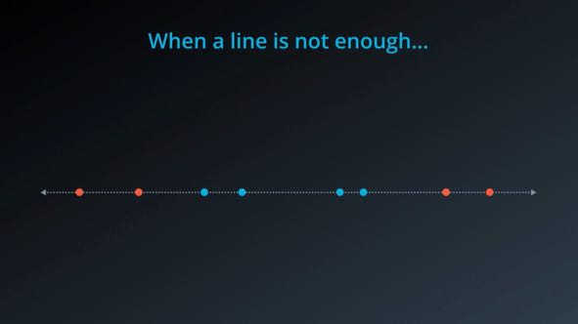
Kernel trick

Slide 29
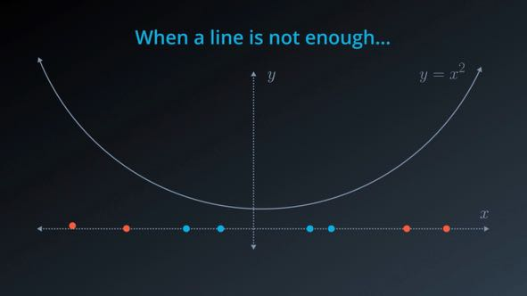

Slide 30
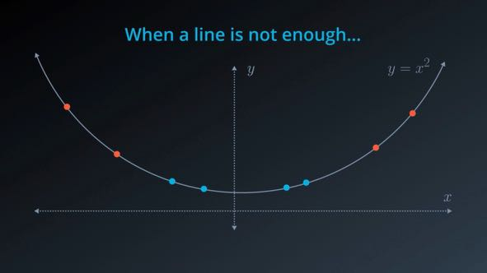

Slide 31
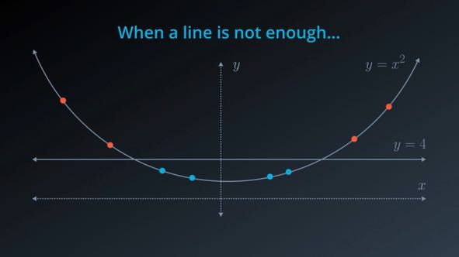

Slide 32
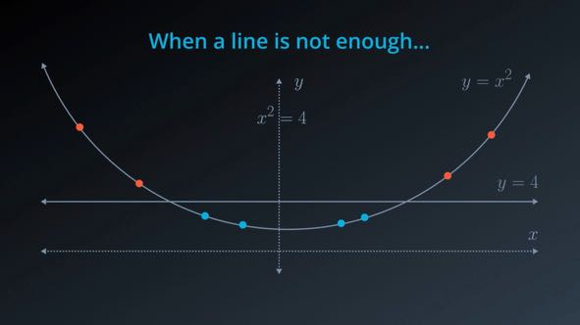

Slide 33


Slide 34
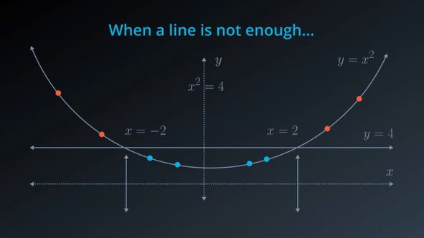

Slide 35
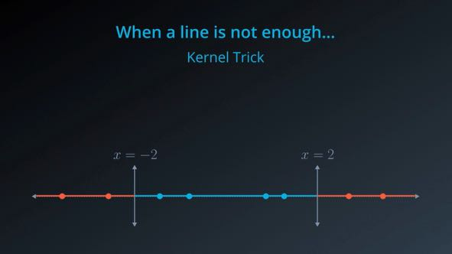

Slide 36
SVM
See stat_quest screenshot

Slide 37
Random forest
See statquest screenshot

Slide 38
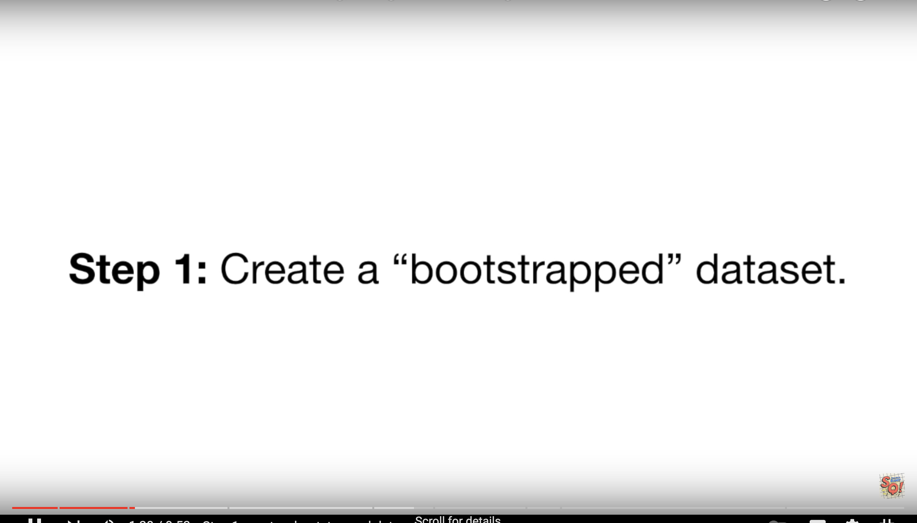

Slide 39
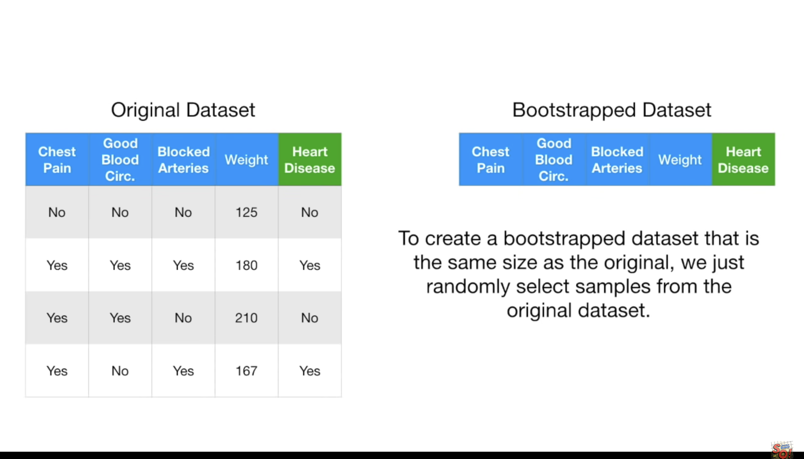

Slide 40
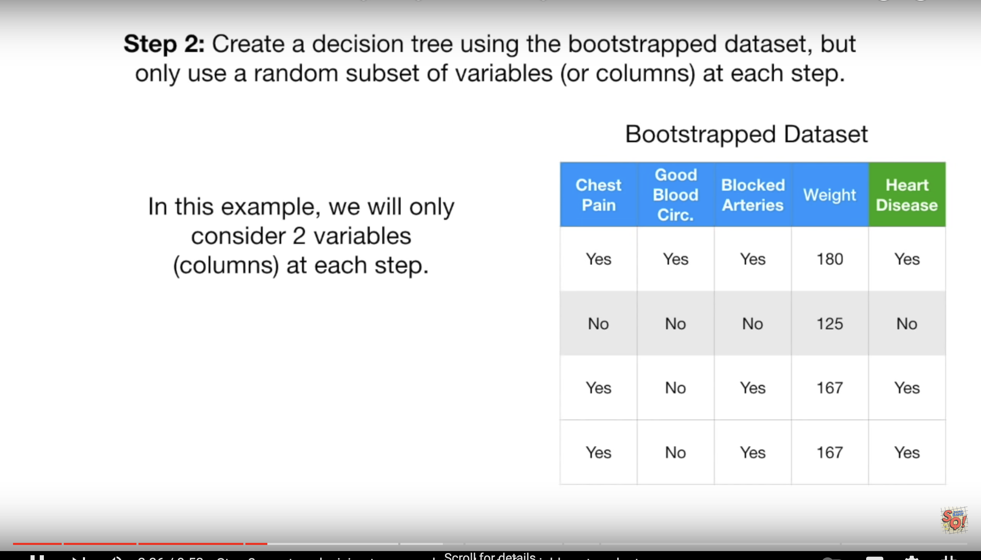

Slide 41
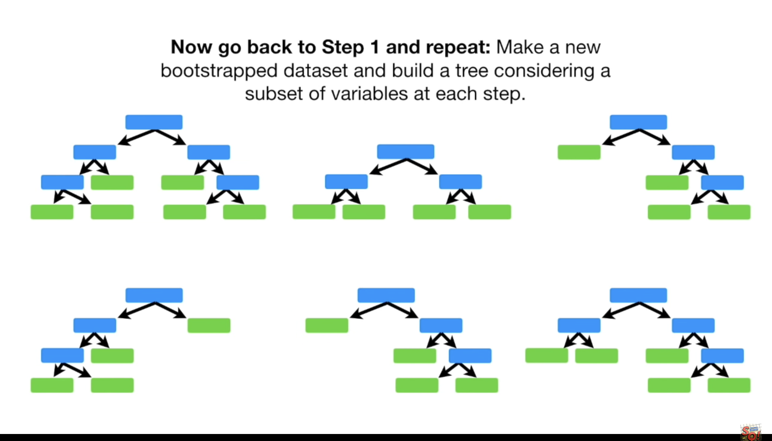

Slide 42
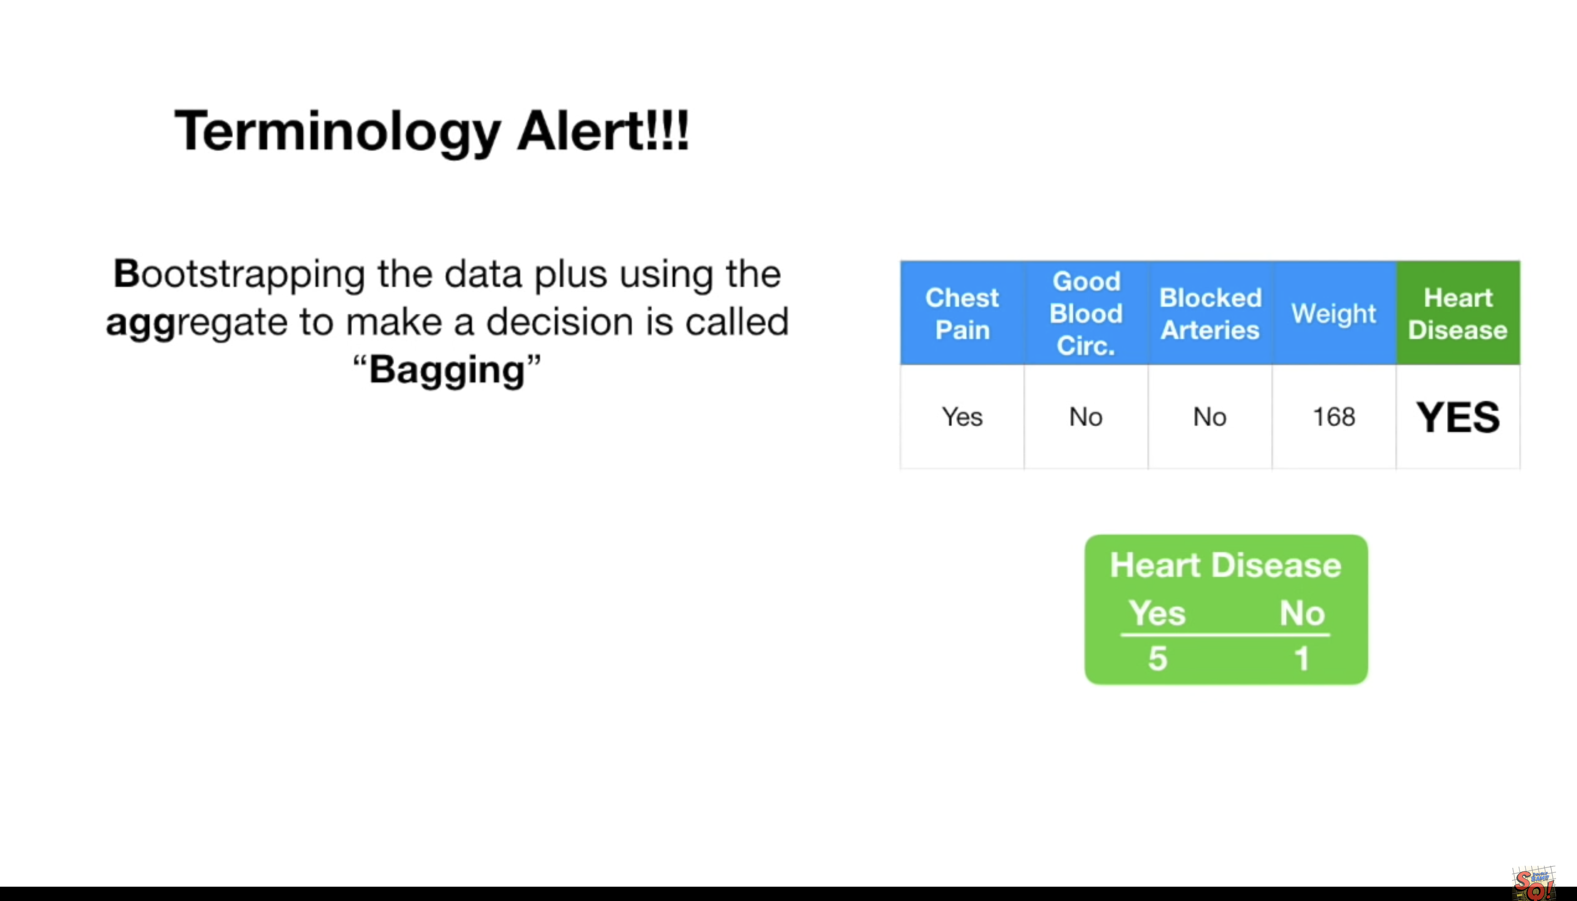

Slide 43
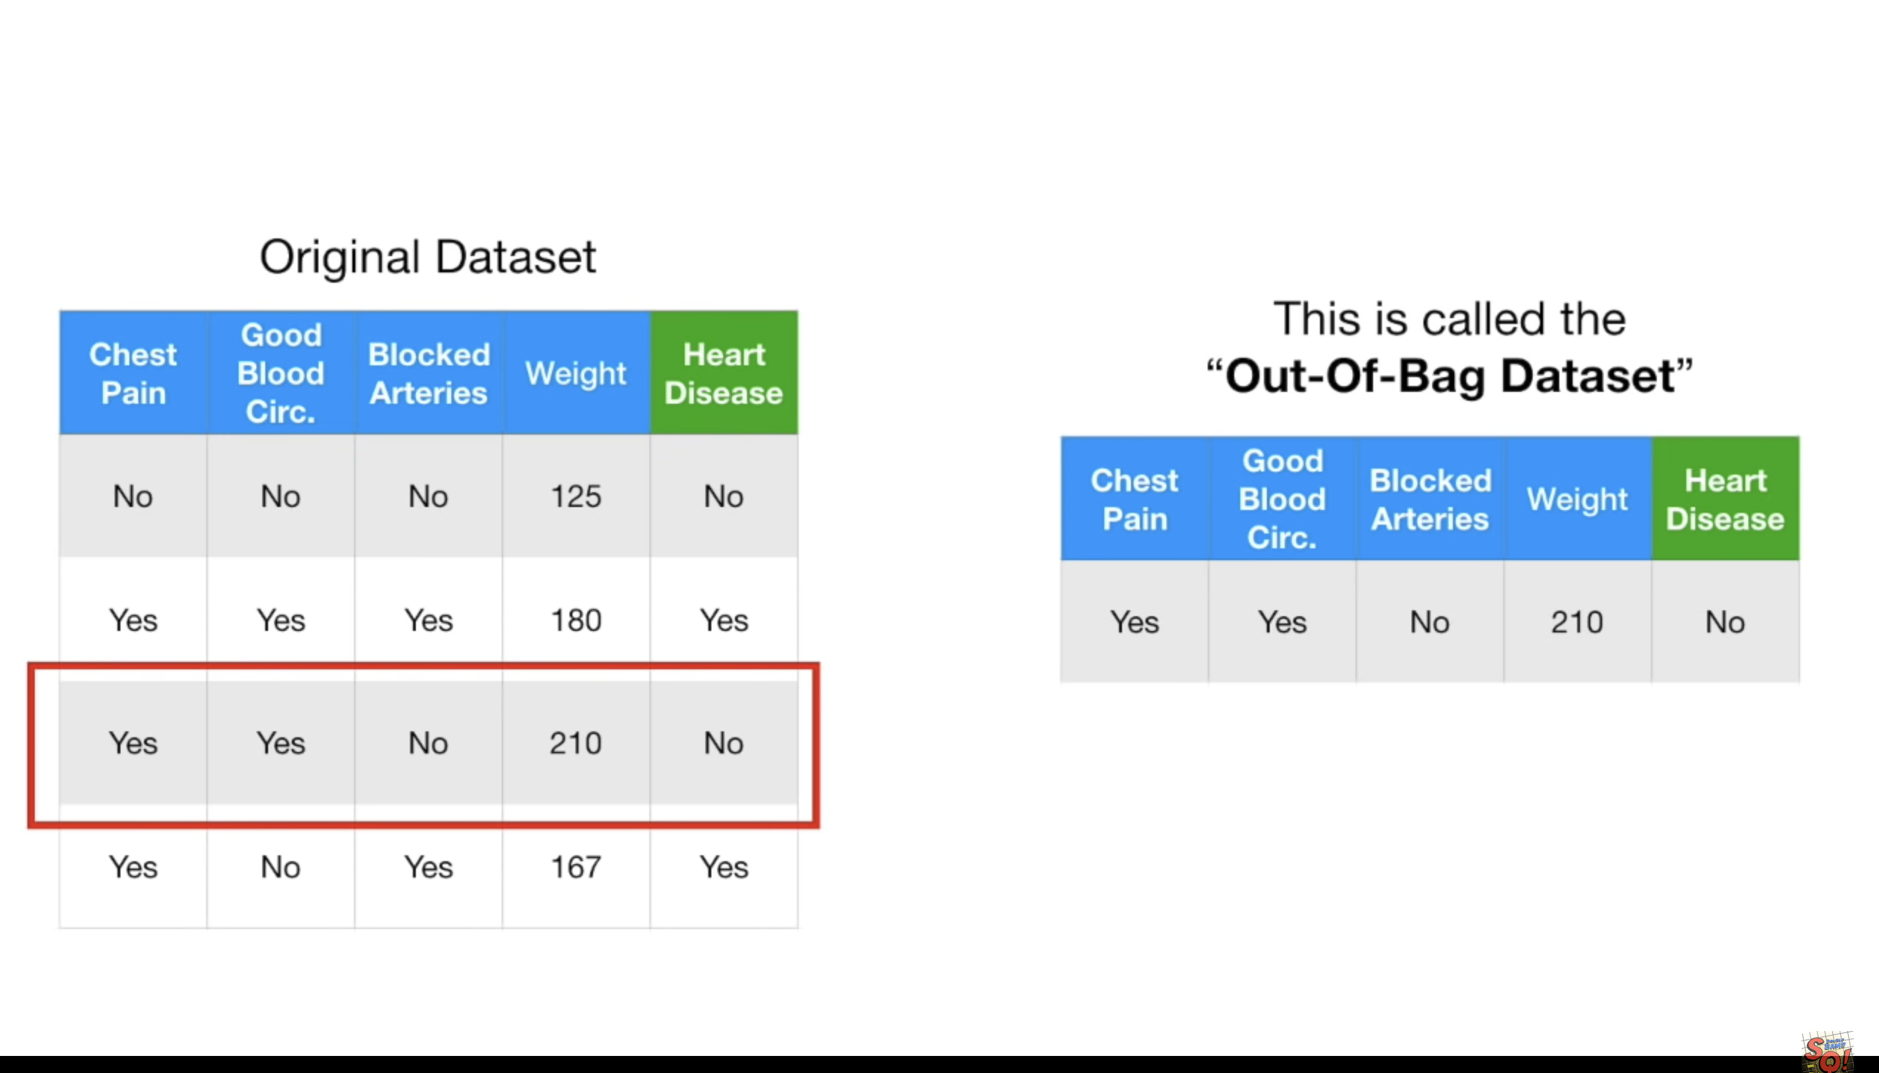

Slide 44
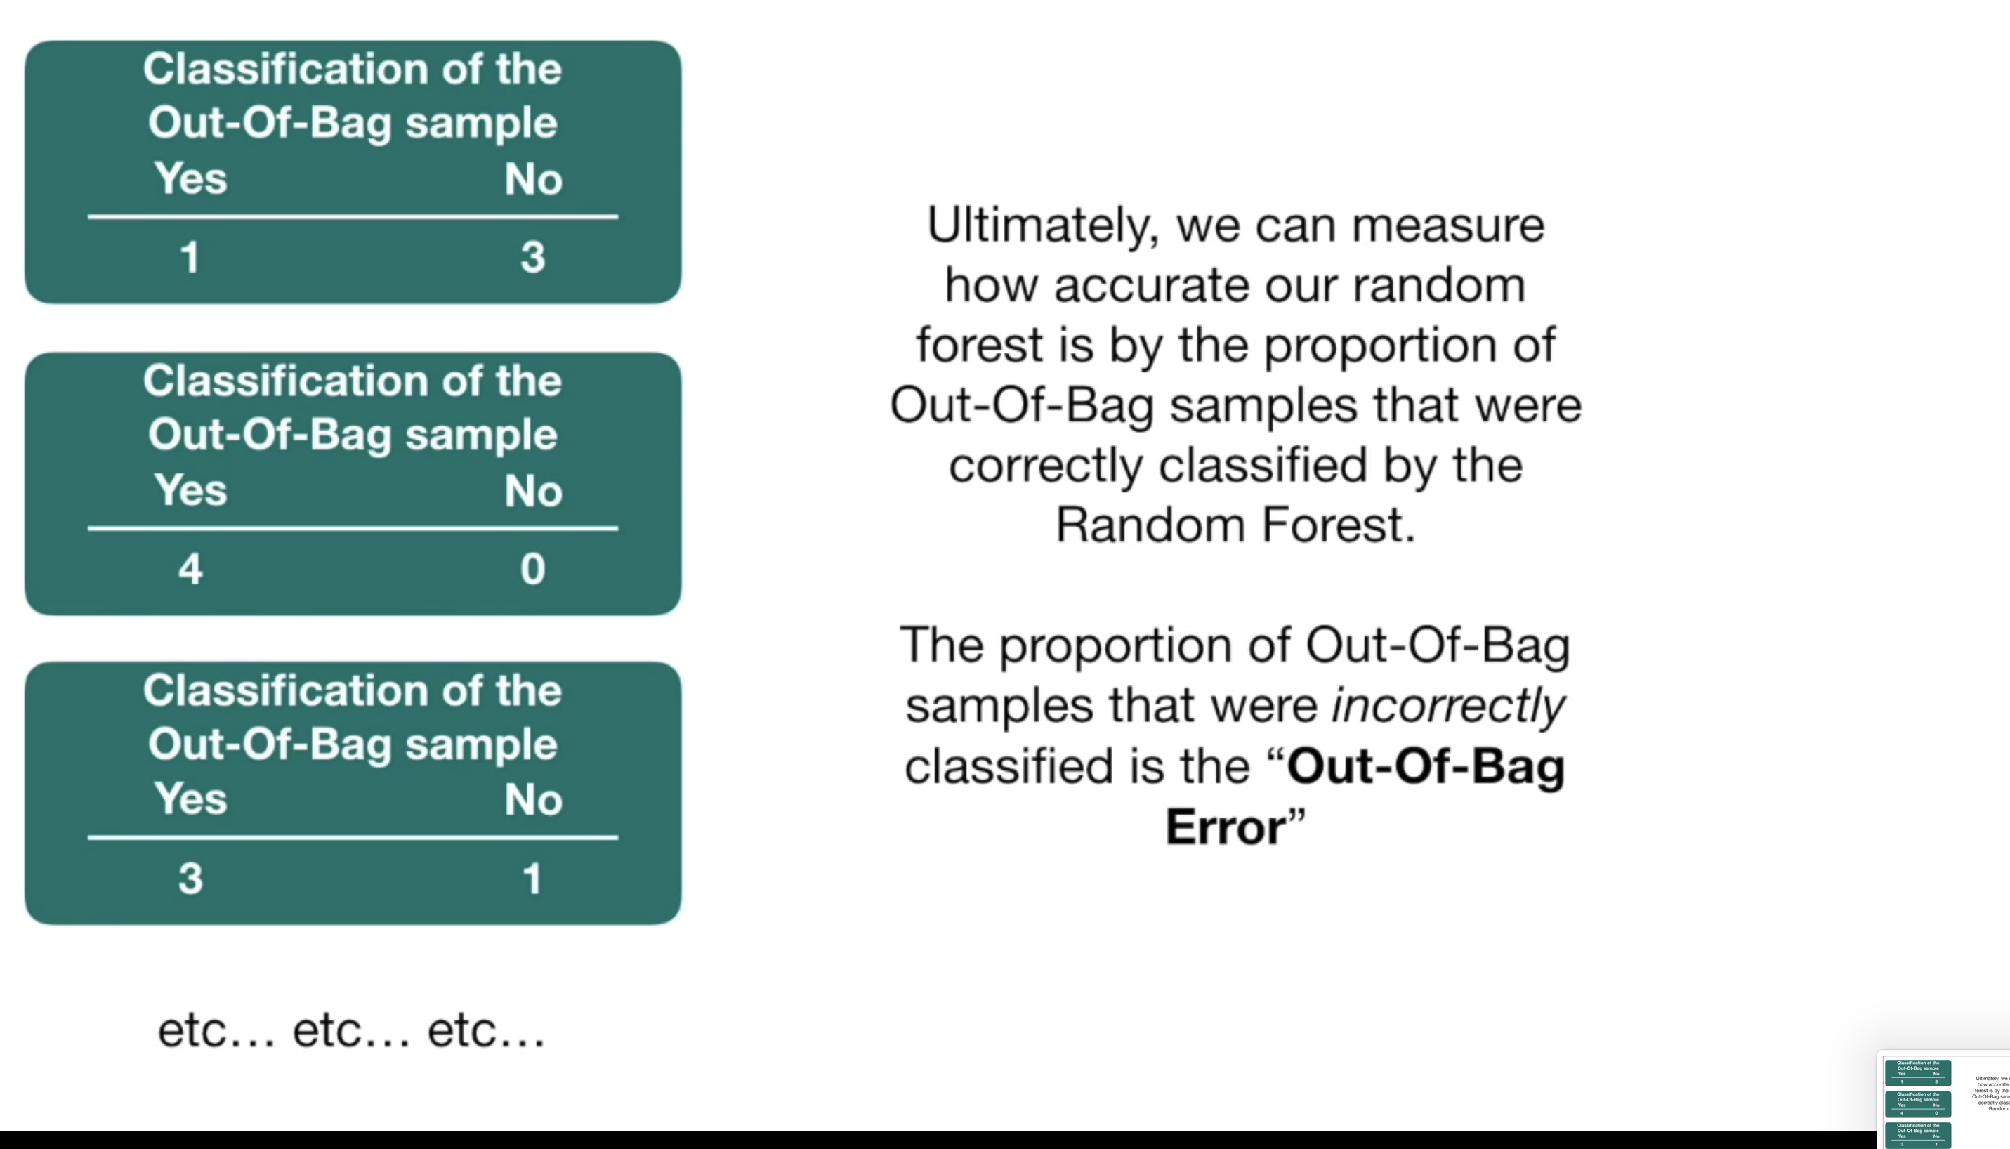

Slide 45
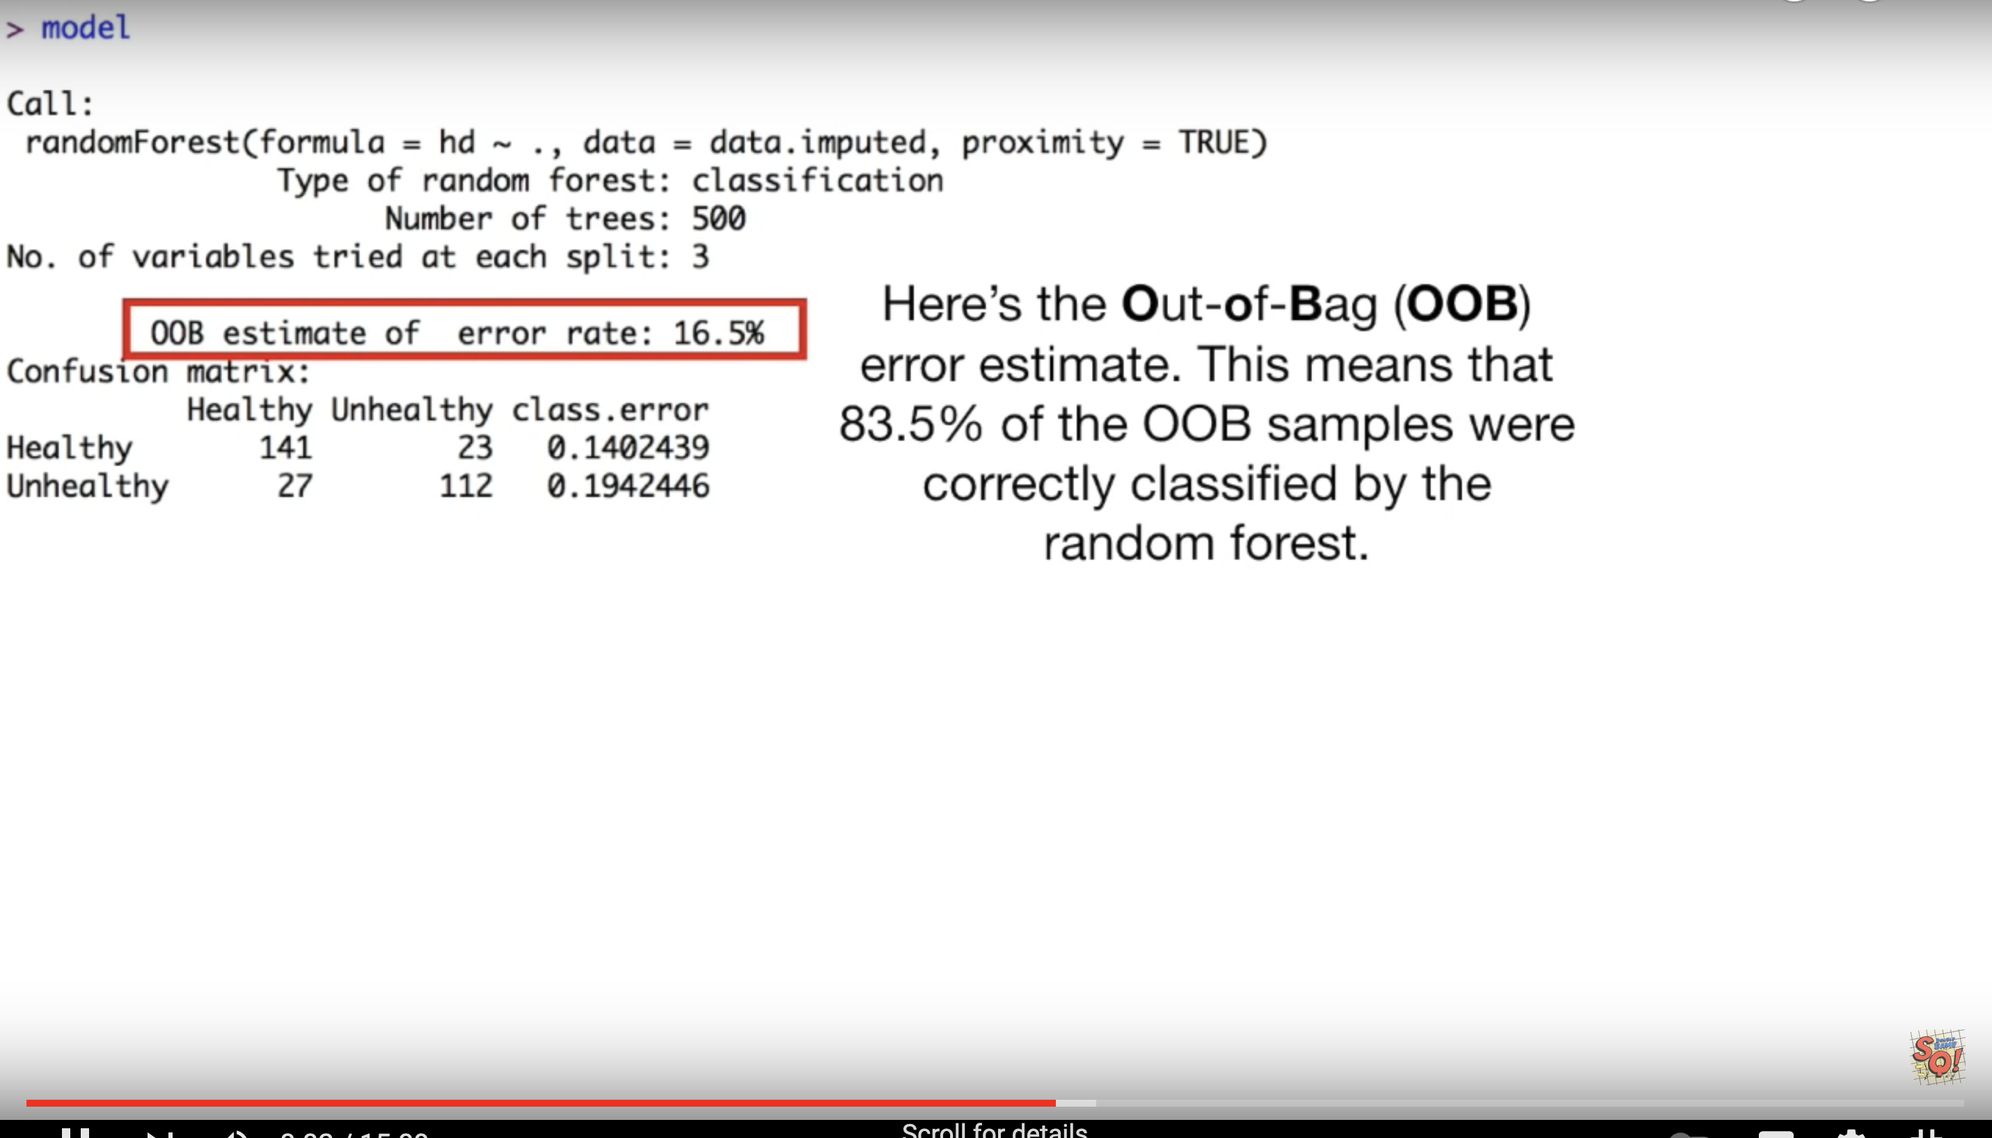

Slide 46
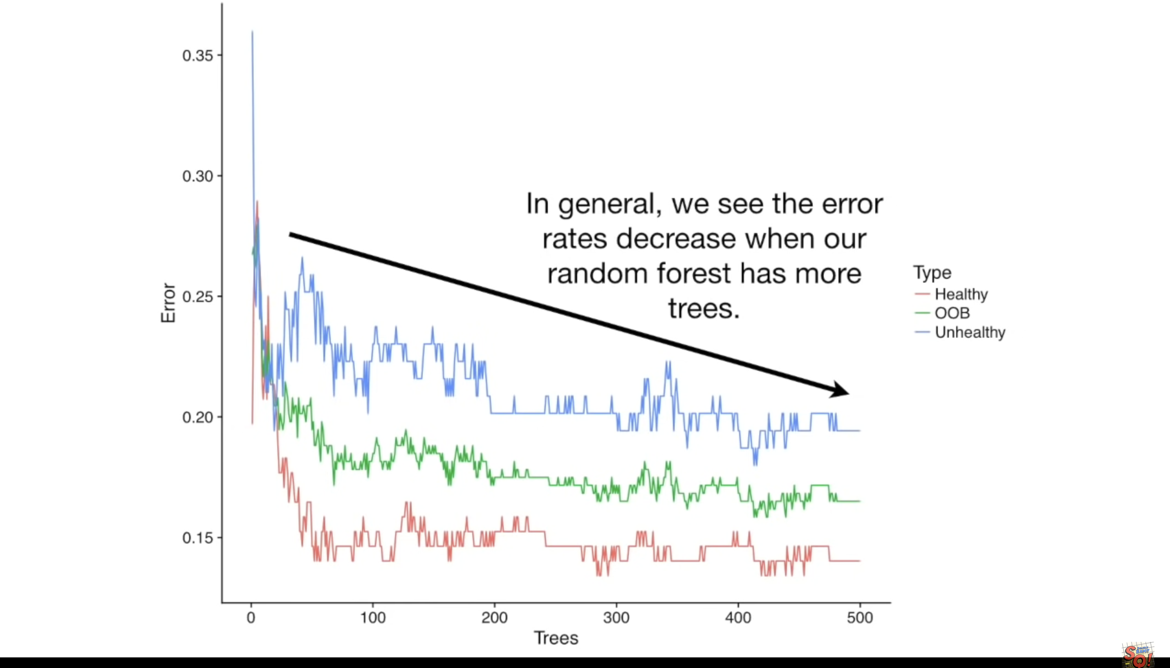

Slide 47
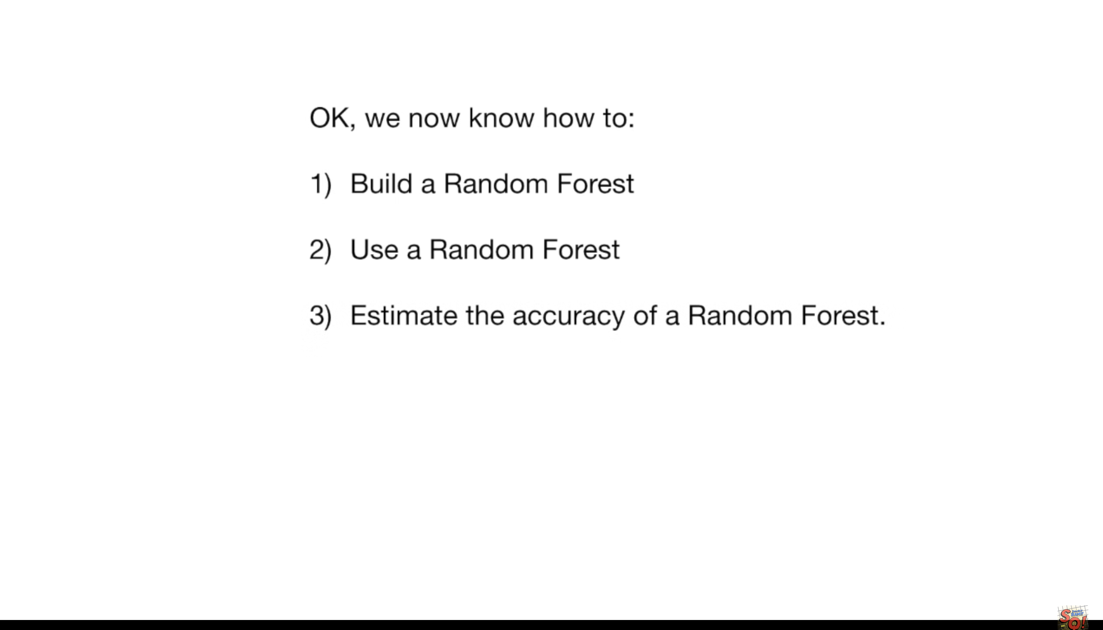

Slide 48
https://scikit-learn.org/stable/modules/ensemble.html#forest

Slide 49
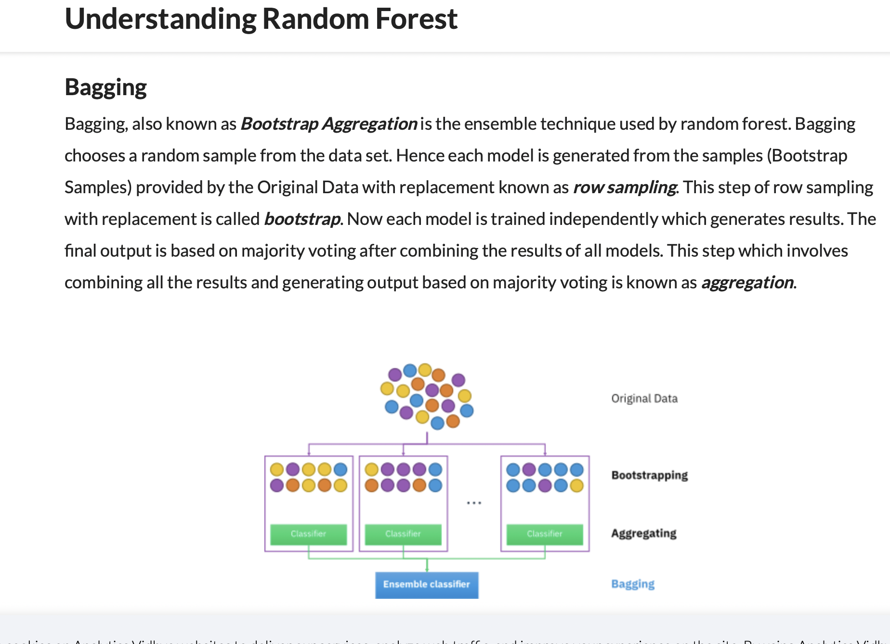
Notes:
https://www.section.io/engineering-education/introduction-to-random-forest-in-machine-learning/

Slide 50
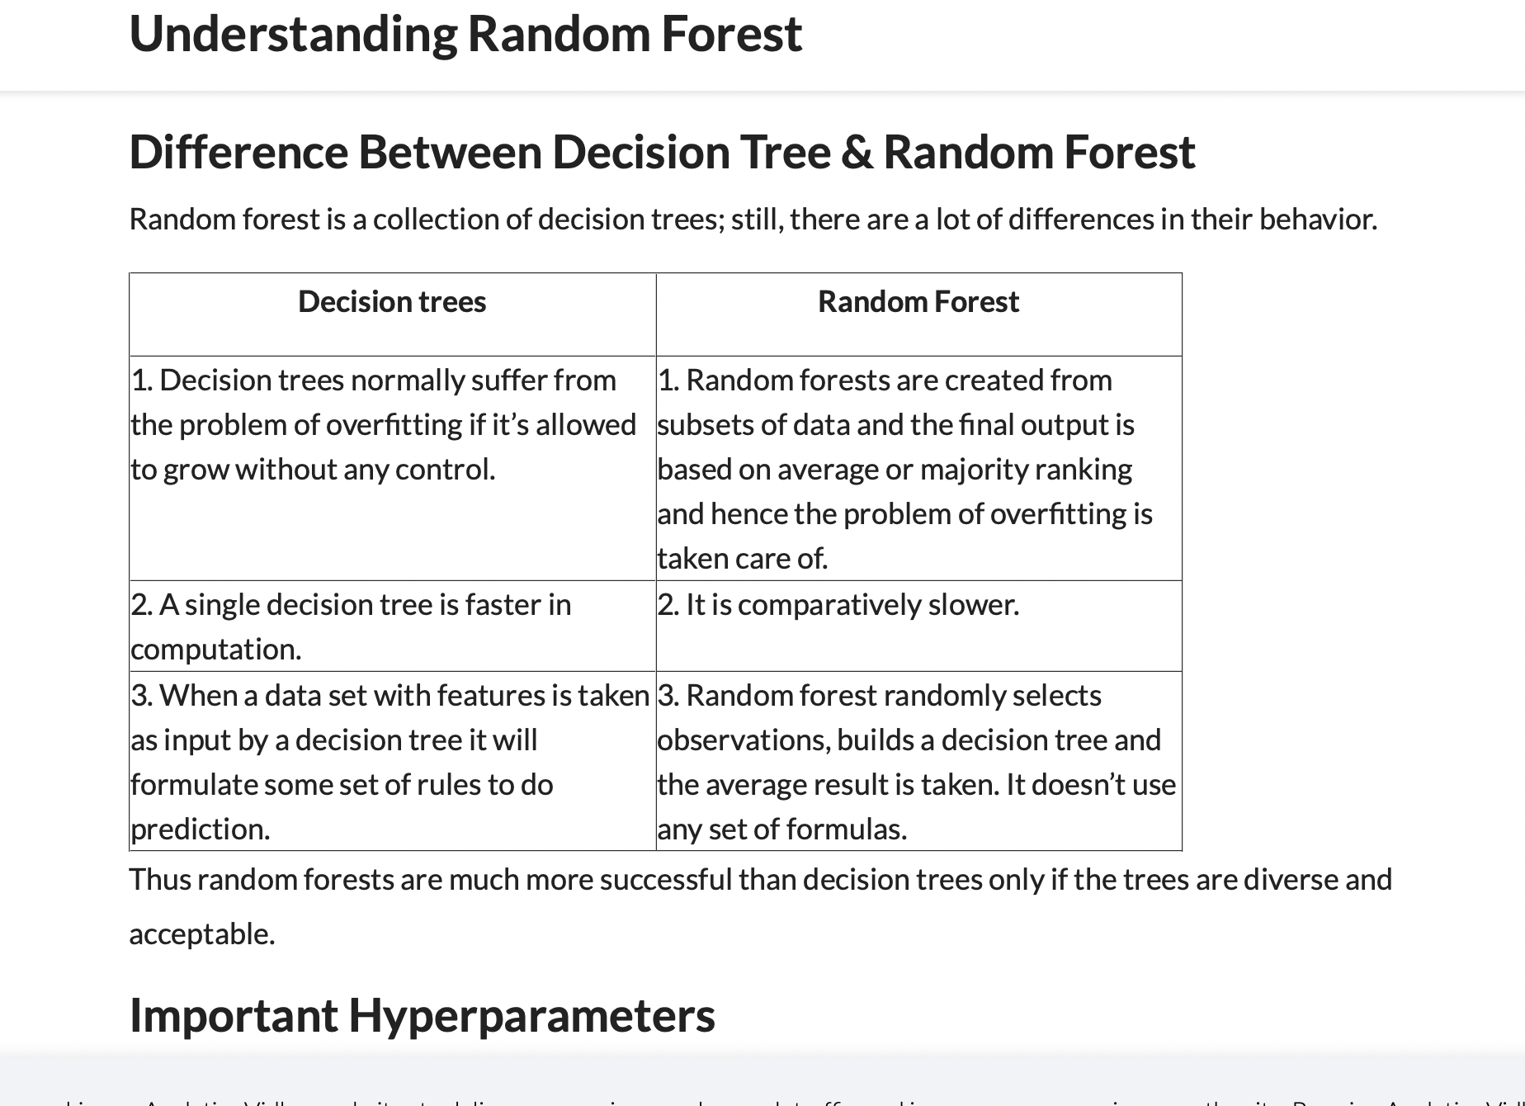
Notes:
https://www.analyticsvidhya.com/blog/2021/06/understanding-random-forest/

Slide 51
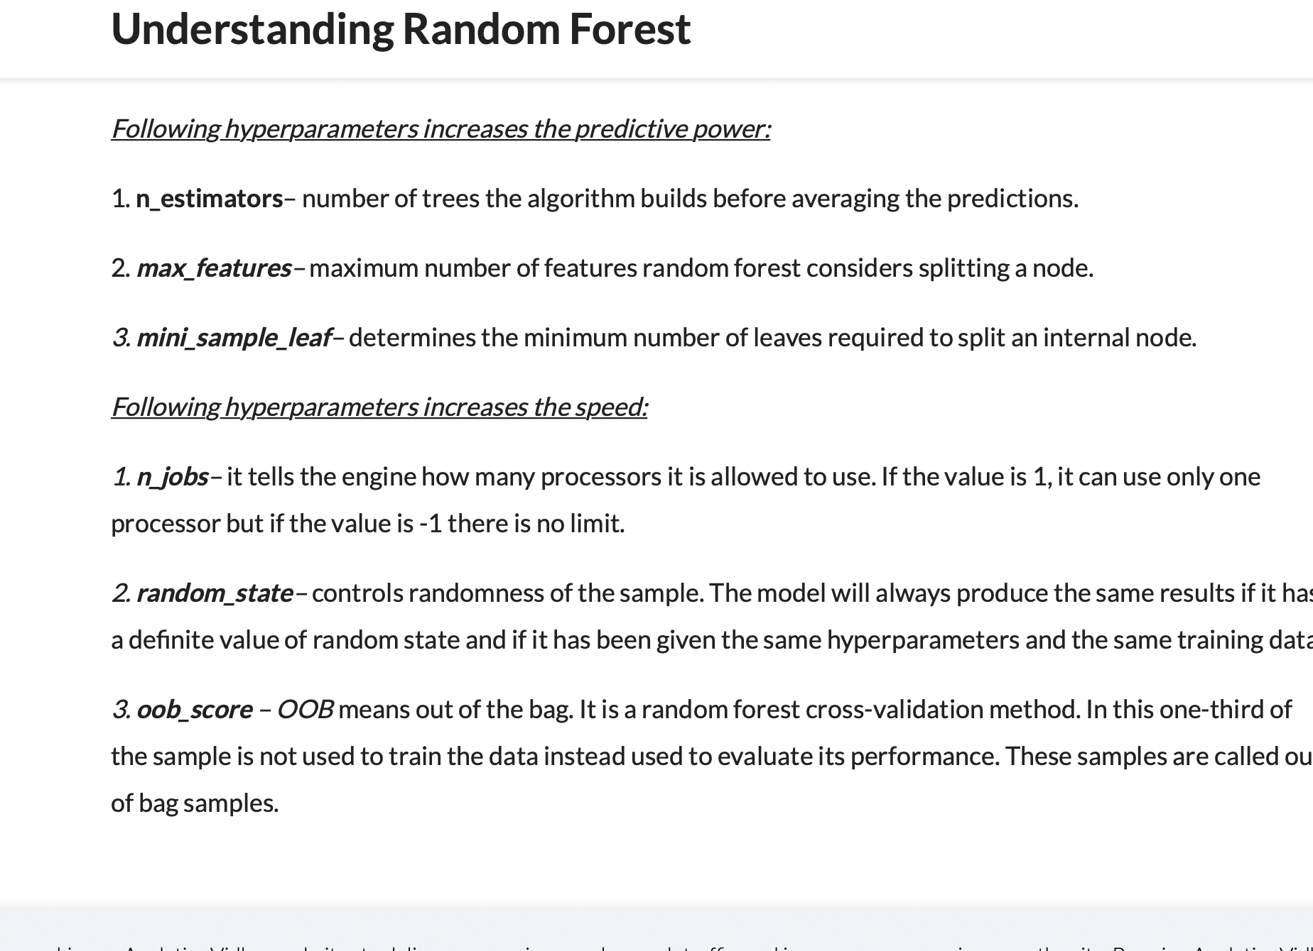

Slide 52
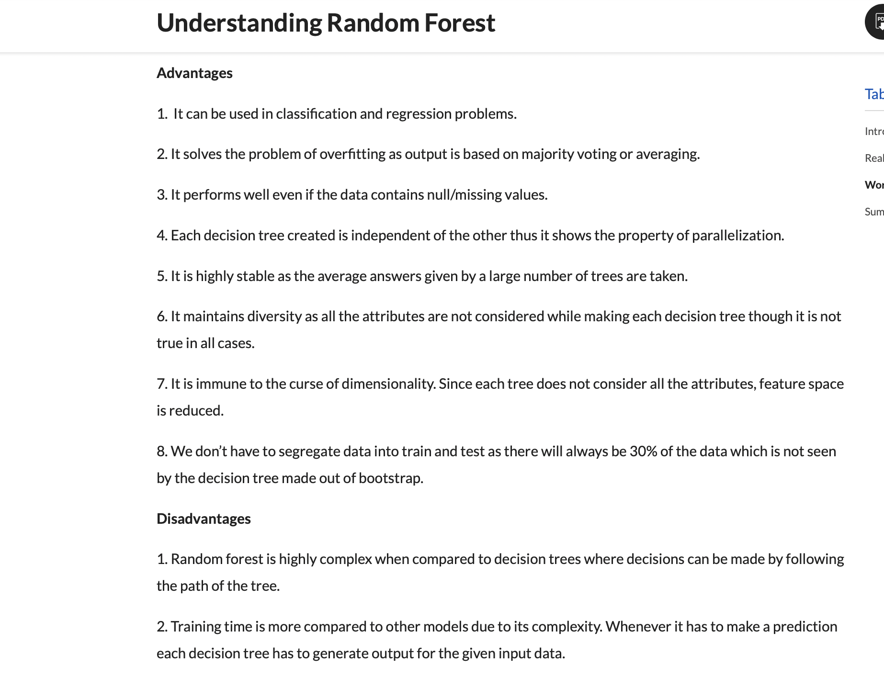

Slide 54
Evaluation and model selection

Slide 55
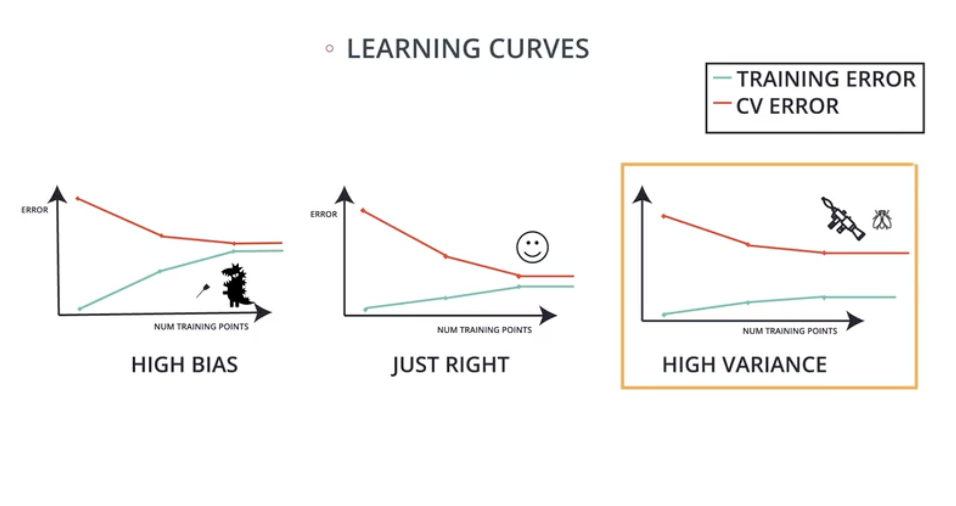

Slide 56
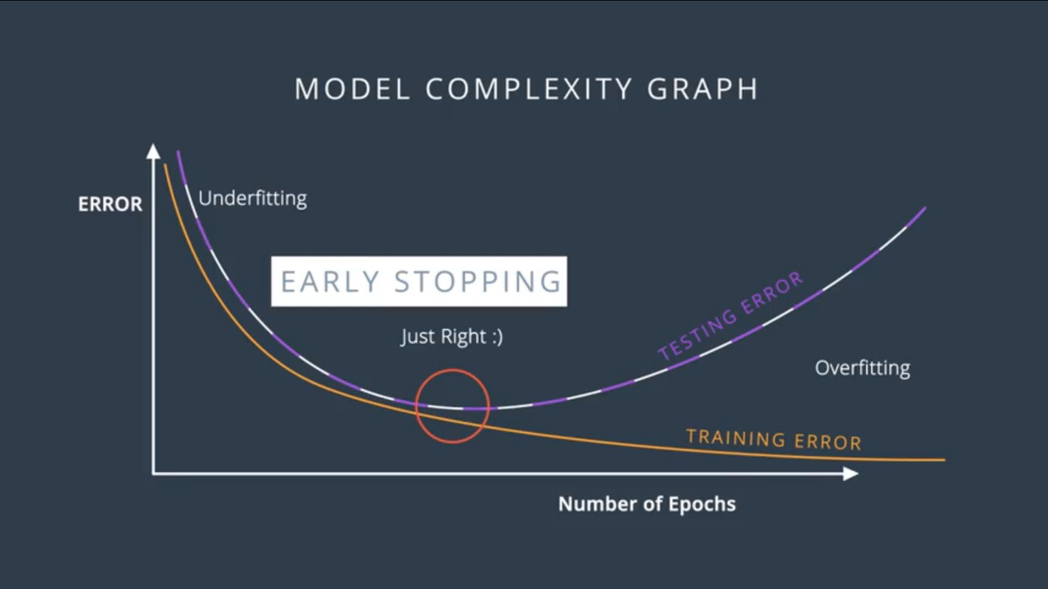

Slide 57
